Slide 1
The role of English language
in people’s life.
Резникова Оксана Владимировна
Учитель английского языка
МОУ «Мачешанская СОШ»
Волгоградская область
Киквидзенский район

Slide 2
PLAN
1.
English is a means of communication.
2.
English is popular everywhere.
3.
English helps us in our life.
4.
Rules of learning English.

Slide 3


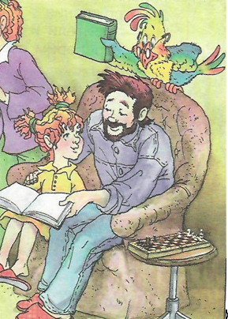
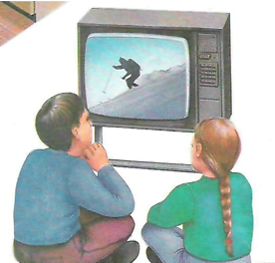

Means of communications

Slide 4

to chat on the Internet
to get new information
to have an English-speaking pen-friend
to watch video

Slide 5
To phone my friends and parents
To send messages
To listen to music

Slide 6
What was the first
means of communication
?

Slide 7

Language

Slide 8
PLAN
PLAN
1.
1.
English is a means of communication.
English is a means of communication.

Slide 9
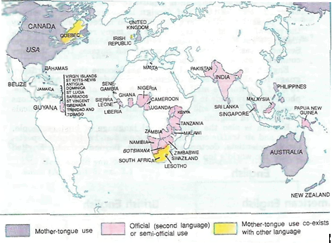

Slide 10
60% of all international telephones calls are made in English
More than 60% of all scientific journals are written in English.
80% of all information in the world’s computer is in English.
75% of world’s letters and faxes are in English.

Slide 11
PLAN
1.
English is a means of communication.
2.
English is popular everywhere.

Slide 12

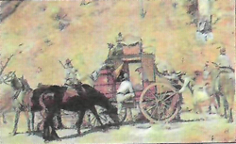




To watch films
in the original
To find a job
abroad
To go abroad
on an exchange
programme
ENGLISH
To travel
everywhere
in the
world
To earn
a lot of money
To find
new friends

Slide 13
PLAN
1.
English is a means of communication.
2.
English is popular everywhere.
3.
English helps us in our life.

Slide 14


Slide 15
isolation [aisә’lei∫n] – the state of being alone or lonely;
up-to-date – modern, fashionable;
average [‘æνәridз] – ordinary, not special;
far more difficult – very difficult;
at a time – separately or in groups of two, three on each occasion;
to get sth wrong – to make a mistake;

Slide 16
What does Ann find the most
difficult in learning English?
What advice does Ann give to
people who are just beginning
to learn English?

Slide 17
TRUE | FALSE

Slide 18
TRUE | FALSE
1. Ann is planning to become an interpreter. 4. The most difficult part of pronunciation is intonation. 6. Ann looks words up in the dictionary. 8. The most difficult feature of any language is learning the elements for which there are no written rules. | 2. You don’t need to practice grammar together with vocabulary. 3. She has some problems learning words connected with her hobby. 5. It’s not important to learn both formal and informal English. 7. Listening to the news in English doesn’t help Ann.

Slide 19
Ann thinks about:
learning grammar;
2. learning vocabulary (words and idioms);
3. learning pronunciation;
4. reading;
5. listening to pop music, the radio, watching videos and educational TV programmes.
You need to practice grammar together with vocabulary
It’s better to learn a few words at a time and practice them
It’s important to learn both formal and informal English
You need to look words up in the dictionary and make a note of the most useful ones
You need to listen to them

Slide 20
You need to practice grammar together with vocabulary
It’s better to learn a few words at a time and practice them
It’s important to learn both formal and informal English
You need to look words up in the dictionary and make a note of the most useful ones
You need to listen to them

Slide 21
PLAN
1.
English is a means of communication.
2.
English is popular everywhere.
3.
English helps us in our life.
4.
Rules of learning English.

Slide 22
English is a way
to better life.
James Thurber

Slide 23
Home task
Write an essay
"The role of English in my life"

Slide 24
Thank you
for the lesson

Slide 25
Используемые ресурсы
English VII – УМК с углубленным изучением английского языка под редакцией О.В. Афанасьевой, 2006
Happy English.ru – УМК для 8 класса под редакцией К.И. Кауфман, 2008
Exam Excellence. Preparation for secondary school exams- Oxford, 2007
(картинки взяты из этих учебников)

Slide 26
http://s50.radikal.ru/i127/1102/39/995a595edc85.jpg
http://s54.radikal.ru/i145/1102/f0/926b843f965c.jpg
http://i028.radikal.ru/1102/e7/8161b9a69c1b.jpg
http://s59.radikal.ru/i165/1102/6c/61d613b6960a.jpg
http://s51.radikal.ru/i133/1102/e6/5320a0fe28f7.jpg

