Slide 1
Тема урока: “What keeps a family together? What makes it happy?”
Обобщающий урок
по страноведению
в 11-м гуманитарном классе
в рамках темы
«Семейная жизнь и традиции»
Автор:
Смирнова Ольга Геннадьевна,
учитель английского языка и страноведения
МОУ «Гимназия №2» г. Брянска

Slide 2
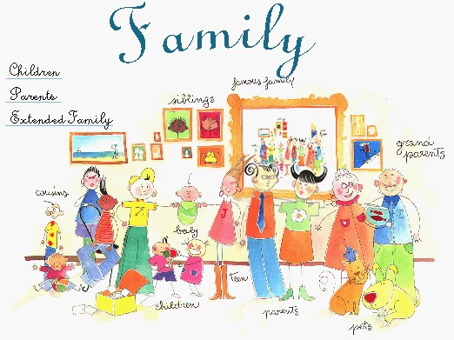
Topic: Family
A family is…

Slide 3
Aim: What keeps a family together?
What makes it happy?
A Happy
Family

Slide 4
Types of marriages
Match:
a marriage agreed for social, political or economic advantage rather than for love.
a marriage based on mutual respect and friendship
a marriage based on mutual love rather than any other considerations
untrue, invented, not real relationship, existing only on paper.
an unsuitable alliance or marriage
marriage existing as a habit.
Love match
Misalliance
A marriage of convenience
Fictitious (paper) marriage
A habitual relation marriage
Marriage of friends

Slide 5
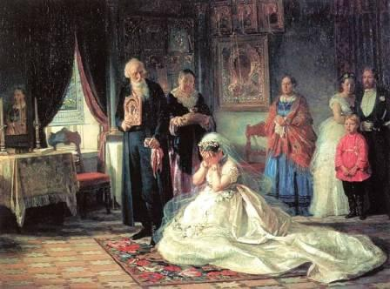

Slide 6
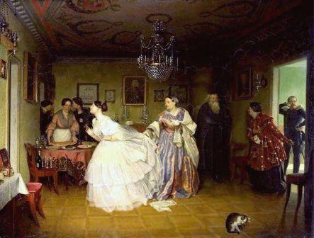

Slide 7
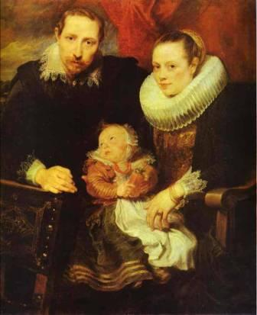

Slide 8


Slide 9
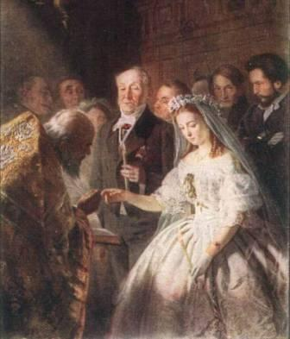

Slide 10
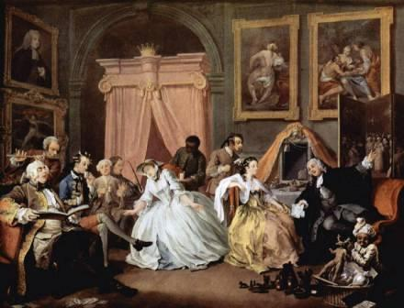

Slide 11
Values Ladder
- Faith
- Children and
their upbringing
- Reliability
- Love
- Traditions
- Warmth
- Care
- Understanding
- Patience
- Responsibility

Slide 12

Social Research: Family Values

Slide 13
Values of the family
50 people
asked
chose:
42
40
31
22
18

Slide 14

How ideal parent and child look like:
Loving
Sociable
Respecting
Diligent
Caring
Inquisitive
Responsible
Responsible
Understanding
Patient
Diligent
Reliable
Caring
Loving

Slide 15

Rules and Duties
Rules: make people responsible,
organized and belonging.
Duties: enhance self-confidence
and self-esteem,
make people feel close,
responsible and caring.

Slide 16

Listening Comprehension:
1) A husband in an ideal family is:
      a) more than nine years older than his wife;
      b) no more than nine years older than his wife;
      c) less than twenty five years old;
      d) the same age as his wife.
  2) Husband and wife sometimes really have conflicts:
      a) because they’ve become steadier in the years of marriage;
      b) as the wife values husband’s status and education and her image
      satisfies him;
      c) because they are moderate in smoking and drinking;
      d) as each of them spends little on the own needs.
      3) A happy family has one striking feature –
        a) they have two children;
        b) they live separately from their parents;
        c) they still make declarations of love to each other;
        d) they prefer to spend time together.

Slide 17

Analytical Reading
Why does the writer say “Marriage is different from love”?
What stylistic devices are used by the writer:
  a) metonymy;
  b) metaphor;
  c ) epithet?
  Give examples.
How do you understand the phrase
“You should know what you are buying”?

Slide 18
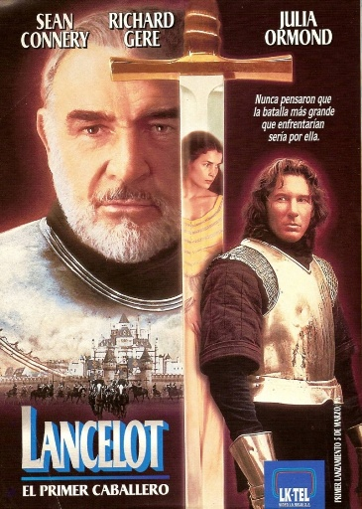
Video
Watching:
-What is the title of the
film?
-What is the film about?
When did the action take
place?
-What are the main
characters of the film?
-What is its genre?

Slide 19
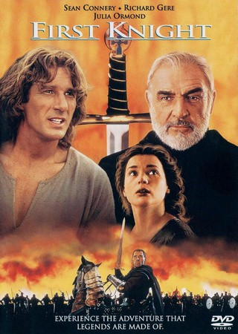
Moral
Dilemma
“If I were…
I would…”

Slide 20

Linguistic Research: Proverbs
The aim:
To define the ways of translating English proverbs and sayings into other languages
* 50 English proverbs
on the topic “Family”
or related to it;
* 10 English proverbs had
similar major meaning
in Russian, German, French

Slide 21
Ways of translating:
Word to word translation
Metaphorical substitute
Metonymical substitute
Metaphoric-Metonymical substitute

Slide 22
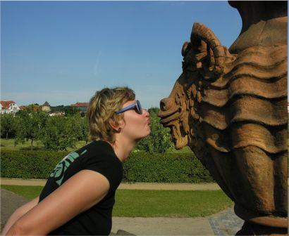
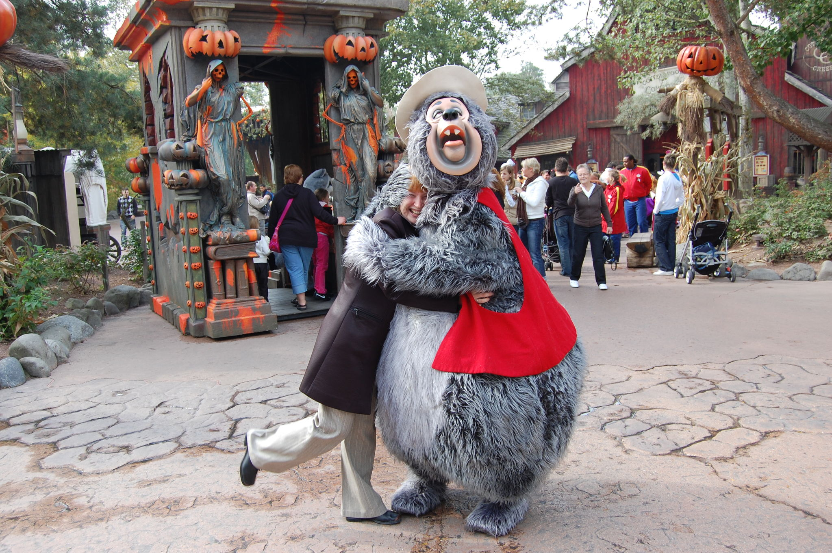
Word to word translation
Eng. Love is blind
Germ. Liebe ist blind
Fr. L’amour est
aveugle
Rus. Любовь слепа

Slide 23

Eng. Marriages are made
in Heaven
Germ. Ehen werden im
Himmen geschlossen
Fr. Les marriage sont
écrits dans le ciel
Rus. Браки заключаются
на небесах

Slide 24

Metaphorical substitute
Eng. Birds of a feather
flock together
Germ. Gleich und gleich
gesellt sirh gern
Fr. Qui se ressemble
s’assemble
Rus. Рыбак рыбака
видит издалека

Slide 25

Eng. Truth comes out of
the mouths of babies
Germ. Kinder und Narren
Sagen die Wahrheit
Fr. La verité sort de la
bouche des enfants
Rus. Устами младенца
глаголит истина

Slide 26
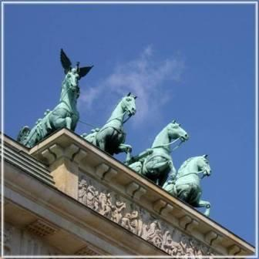
Metonymical substitute
Eng. Every family has a
black sheep
Germ. Kiene Familie onhe
eine Miβgeburt
Fr. Chague tropeau a
sa brebis galeuse
Rus. В семье не без
урода

Slide 27
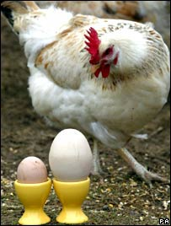
Metaphoric-metonymic substitute
Eng. Don’t teach your
grandmother to suck
eggs
Germ. Die Eier sollten das
Hunt micht belehren
Fr. C’est Gros-Jean qui en
romonte a son curé
Rus. Яйца курицу не учат

Slide 28
Conclusion
1. Any translator or interpreter needs to be aware of the fact that proverbs having the same or the similar meaning in other languages could use different methods to transmit this meaning.
2. These methods show how different the mode of life in the countries is and should be chosen not at will.

Slide 29
Tasks:
Match each proverb to its foreign equivalent
and name the way of translating it:
Маленькие детки- маленькие бедки большие детки- большие бедки
Love is blind
Dem Herzen kannst
du nicht befehlen
Сердцу не прикажешь
L’amour est aveugle
Little children little sorrow, big children, big sorrow

Slide 30

5 reasons to keep family traditions:
Family traditions:
1) create good feelings and special
moments to remember;
2) give every member of the family
a stronger sense of belonging;
3) help teens with their identity;
4) help parents impart the family
values to their children;
5) offer teens a sense of security.

Slide 31


How to keep peace at home?
- Create friendly atmosphere…
To say or not to say???
I’ve told you thousand of times that…
Could you advise me, you are good at…
You are the smartest /most beautiful!
You are like your parents!
Everything is so easy with you!
You’ve become so boring/rude/inattentive!
What on Earth are you thinking of?!
Everybody is/behaves…, but you…
You are up to the mark!
You understand me in the proper way.
Why do you worry me?
How many times should I repeat…

Slide 32
Aim: What keeps a family together?
What makes it happy?
A Happy
Family

Slide 33

Homework:
1) write an essay on the topic:
“A successful marriage is a
building that must be rebuilt
every day”, said Maurois.
What is your opinion?
2) exam-type tasks

Slide 34
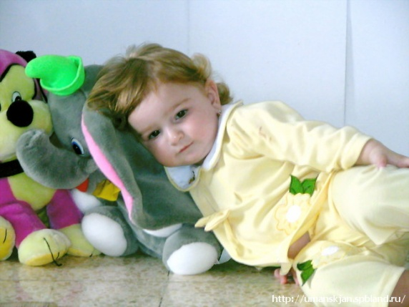
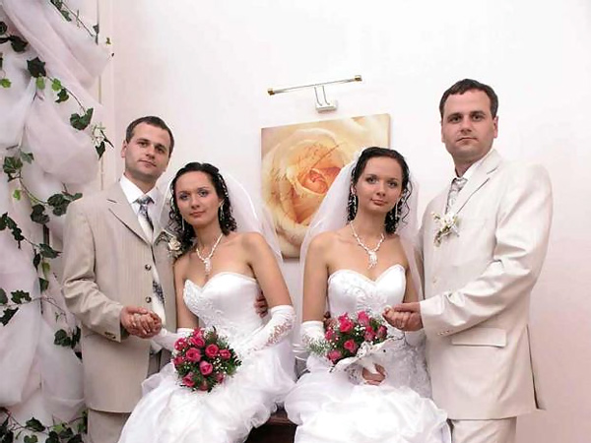

Believe it or not but…
- A British survey of 2,000 people
showed that more men than women
take a cuddly toy* to bed with them.
- In the USA, more than 150 pairs
of identical twins are married to
identical twins.
- Three children in the Norwegian
Henriksen family were born four
years apart on a Leap Day (29th February)

