Slide 1

Family…

Slide 2
Family
People who are closely related
Mother, father and their children
There is no strict definition – a fabulous phenomenon constantly developing

Slide 3
Family Values
Cohesion – being together in one group and nurtured by it
Flexibility − ability to solve different conflicts
Communication − to express themselves freely

Slide 4
Types of families
Nuclear
Extended
Blended (stepfamily)
Same-sex
Childless
Two-parent
Singular (one) parent

Slide 5
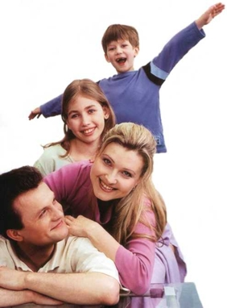
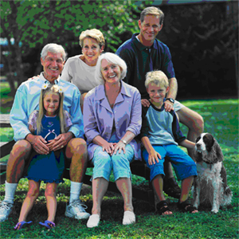
Nuclear Family Extended Family

Slide 6
Stages of creating a family
Dating
Courtship
Engagement (arranged marriage is optional)
Wedding
Divorce (if 2 individuals are not able to maintain friendly and loving relationship to each other)

Slide 7
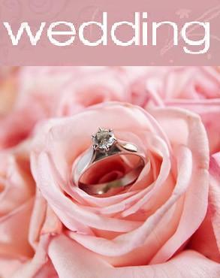

Slide 8
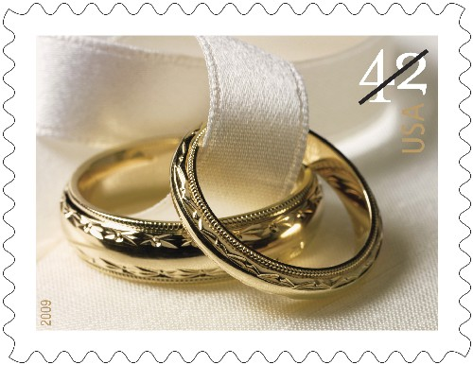
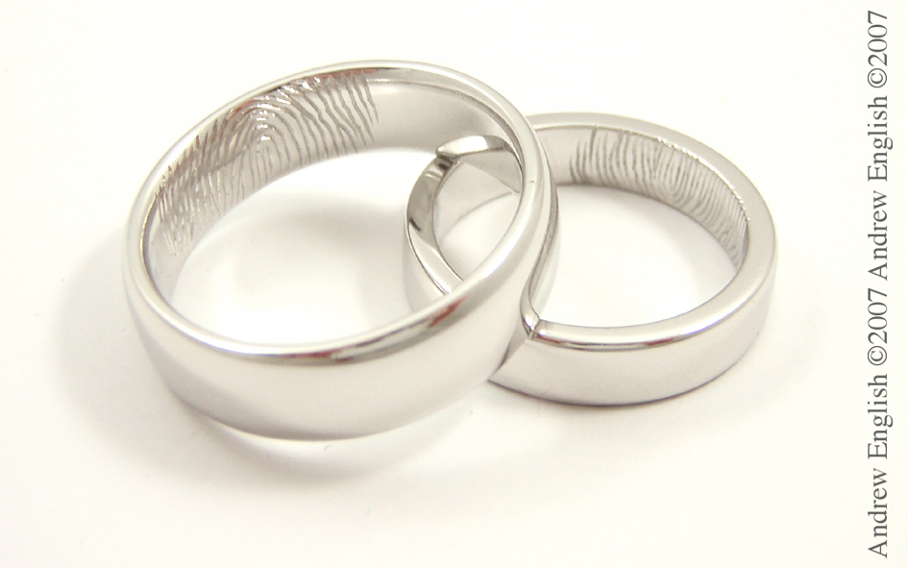
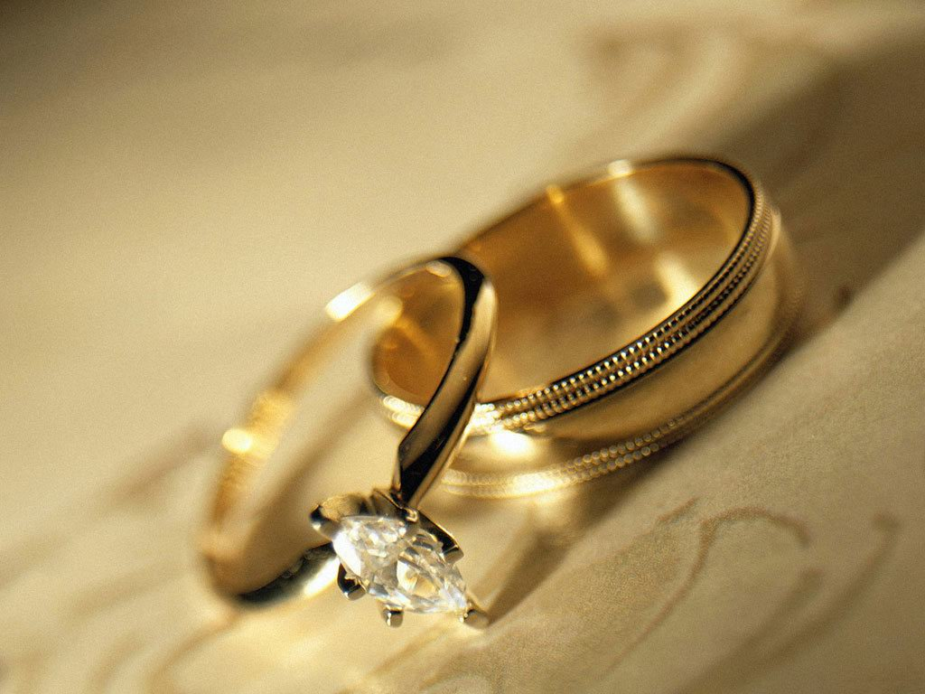
Exchanging of Rings

Slide 9
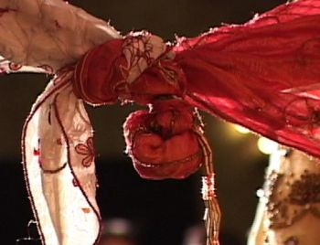
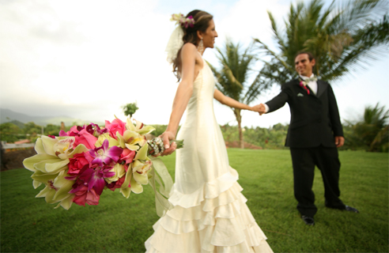
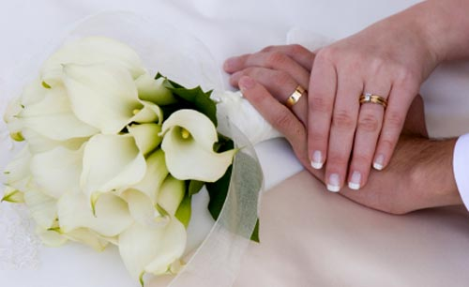
Tying of the garments, joining of hands

Slide 10
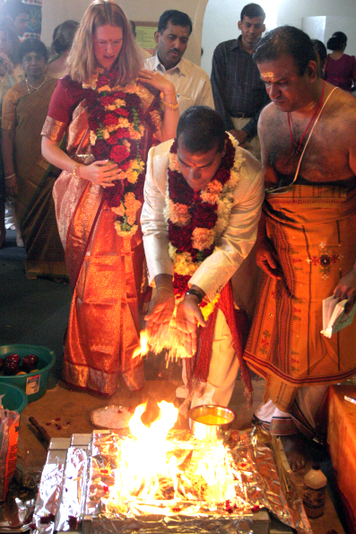
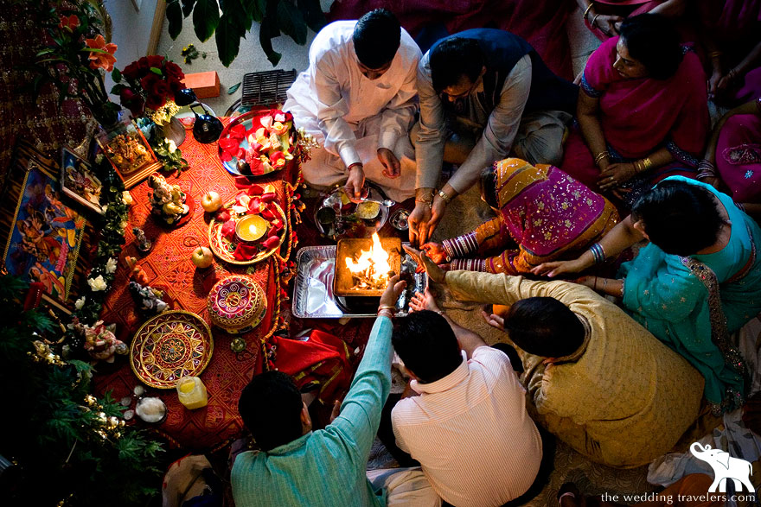
Circle a Sacred Fire

Slide 11
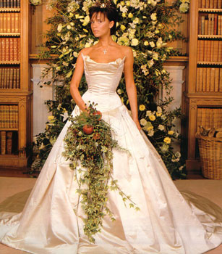
Dressed in White

Slide 12
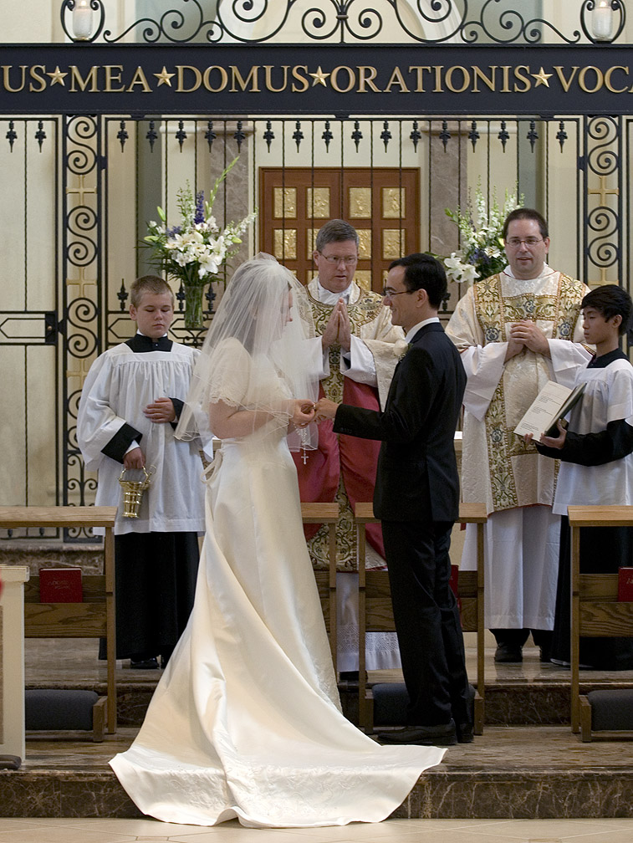
Nuptial Mass

Slide 13
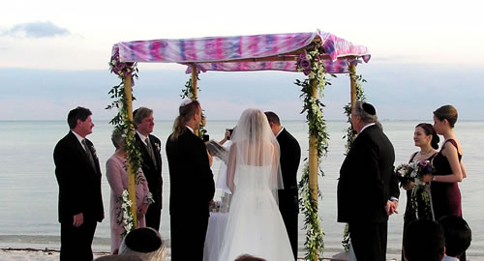
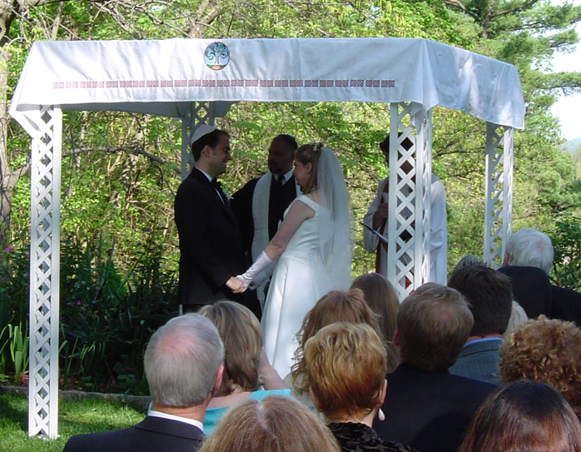
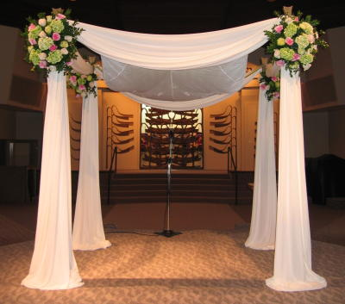
Chuppah – a Canopy

Slide 14
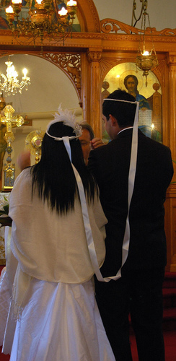
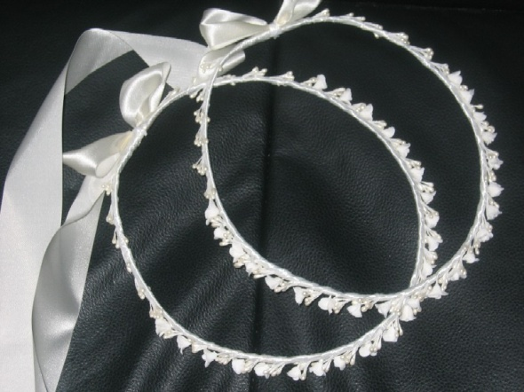
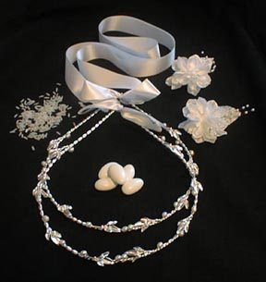
Crowns Attached by a Ribbon

Slide 15
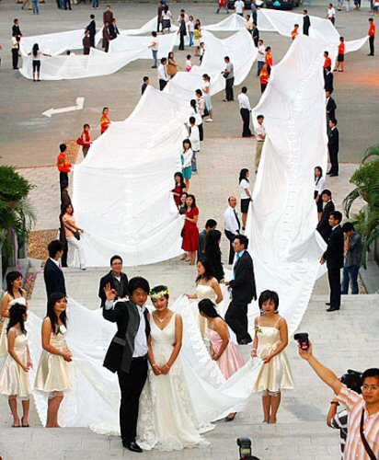
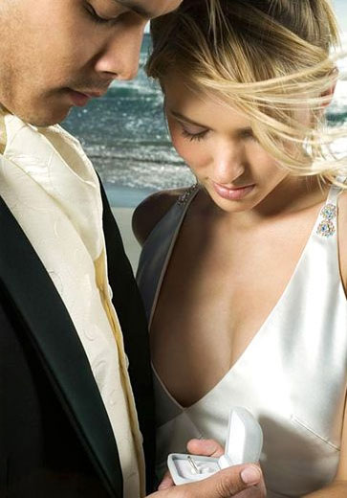
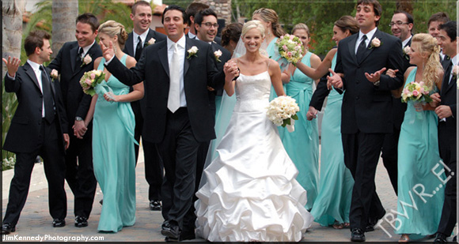
Big Weddings and
A Private Wedding ceremony

Slide 16
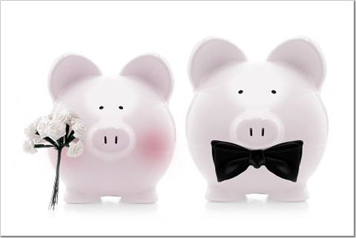

Vows

Slide 17
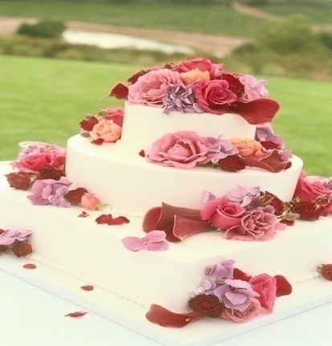
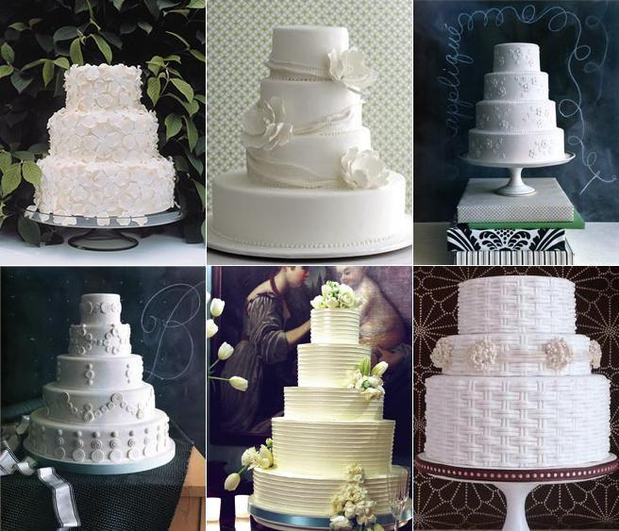
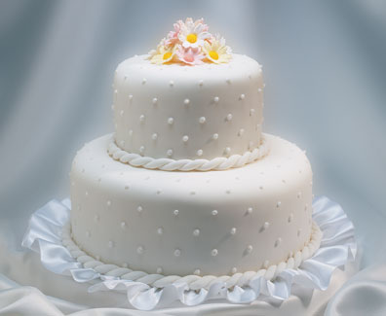
Cake

Slide 18



Honeymoon

Slide 19
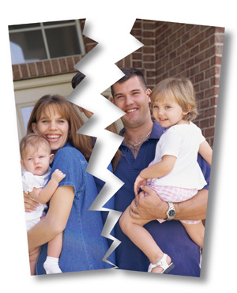
Divorce
Adultery
Desertion
Drunkenness
Conviction of a felony
Cruel
and inhuman treatment

Slide 20

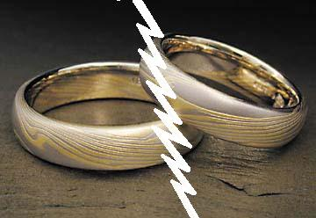

Slide 21
American Family
Individualism
Retirement houses
ECONOMICALLY INDEPENDENT
Dual career families (the gender roles are redefined)
Single-parent families
A transforming institution

Slide 22
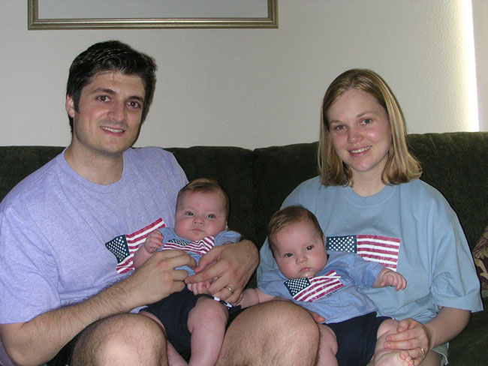

Slide 23
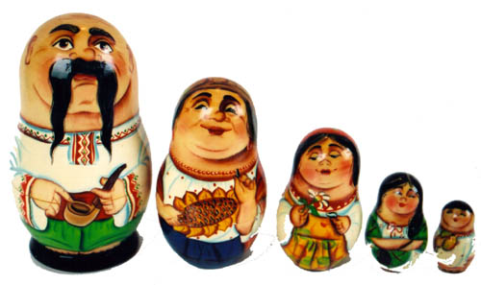
Ukrainian Family
Extended
Skills inherited from parents
A husband is a master of the house
The same social status
Two-parent
Nuclear
Outside the family
Is displaced from the centre of the family
Marriage of convenience
Singular-parent is possible

