Slide 1
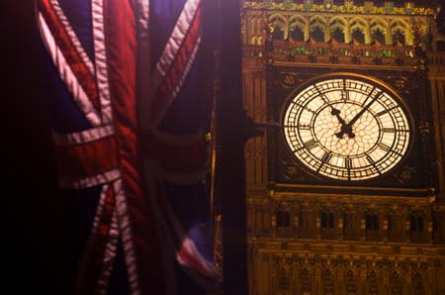
PASSIVE VOICE
Автор: Ладяева Эльвира Гамировна
Уч.английского языка МОУ Татарской гимназии №14

Slide 2
Как часто вы используете пассивный залог в своей речи?
How often do you use Passive Voice in your speech?

Slide 3
Нужен ли Страдательный залог в грамматике английского языка?
Is it necessary to learn the theme Passive Voice?

Slide 4
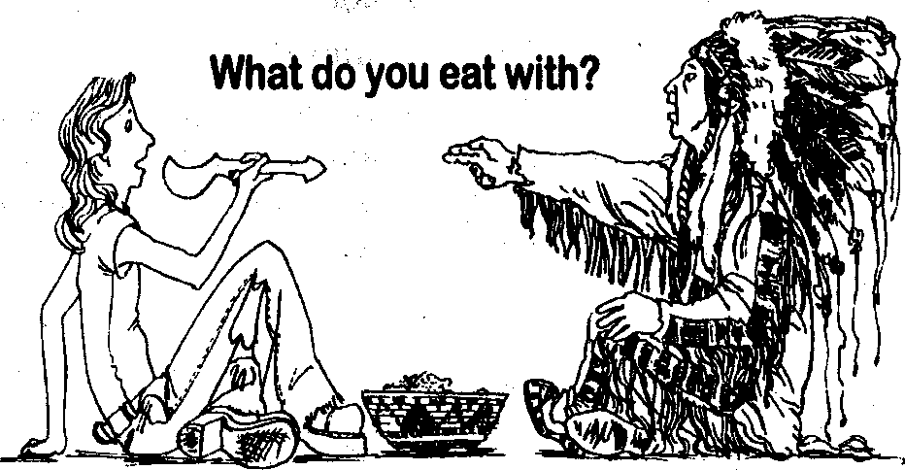
PASSIVE VOICE is used when something is done to the subject
The tomato soup IS BEING EATEN with the spoon

Slide 5
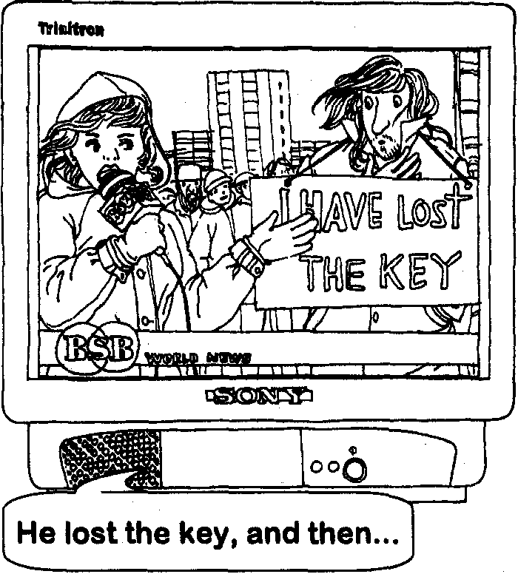
Not long ago the key has been lost by Mr.Fill.

Slide 6

THE GENERAL FORMULA
to BE + V _{3 or V ed}
to be is changed according to the tense and the subject :
Present Simple: to be = am / is / are
The flowers are watered by him every day.
Past Simple: to be = was / were
The flowers were watered by him yesterday.
Future Simple: to be = shall / will be
The flowers will be watered by him tomorrow.

Slide 7
ACTIVE VOICE
 | Simple | Progressive | Perfect | Perfect Progr.
Future | Shall/will V |  | Shall/will have V3
Present | V (s) | Am/is/are + V ing | Have /has V3
Past | V 2 | was / were + V ing | Had V3
do not exist in Passive Voice

Slide 8

Let’s practise

Slide 9
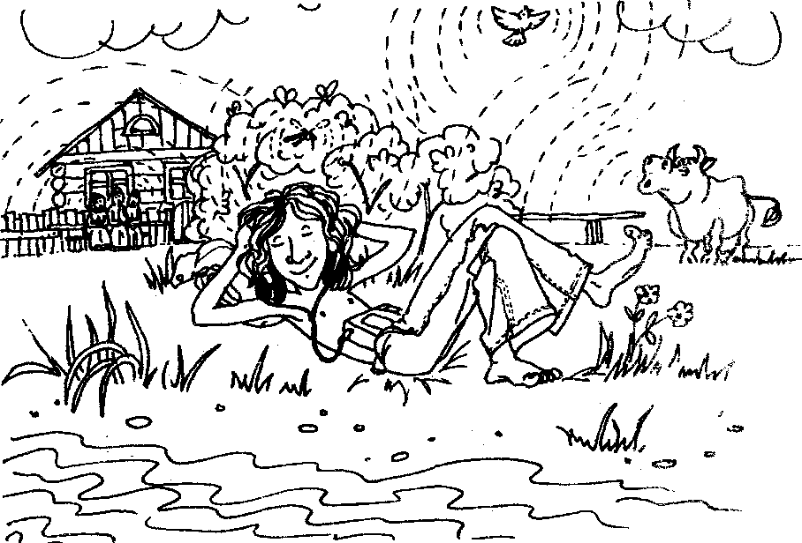
Music/ listen/ Hippi
Music is being listened by Hippi .

Slide 10
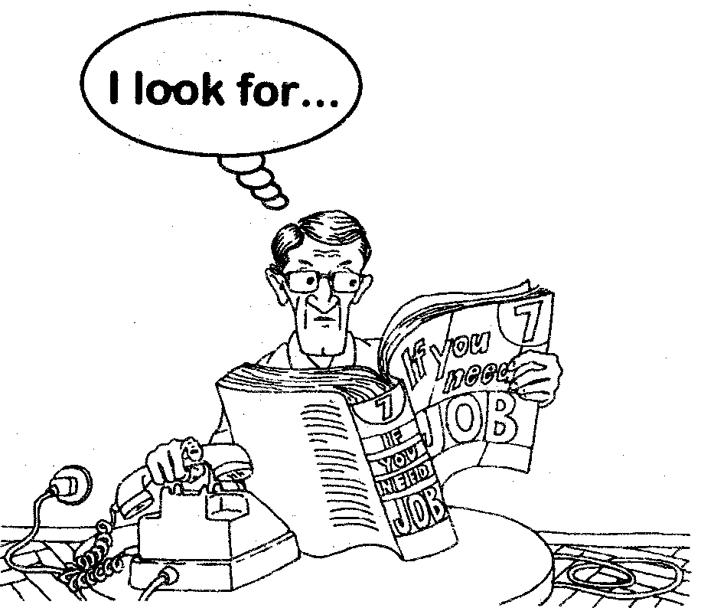
The newspaper /read /the unemployed person
The newspaper is being read by the unemployed person.

Slide 11
PASSIVE VOICE
be + V3 or V ed
 | Simple | Progressive | Perfect | P.P
Future | Shall/will be + V3 |  | ?
Present | Am/is/are V3 |  | ?
Past | Was/were V3 |  | ?
Am/is/ are + V ing
+ to be + V3
______________________
Am/is are + being + V3
Big Ben is being reconstructed now.

Slide 12
PASSIVE VOICE
be + V3 or V ed
 | Simple | Progressive | Perfect | P.P
Future | Shall/will be + V3 |  | ?
Present | Am/is/are V3 | Am/is/are + +being+V3 | ?
Past | Was/were V3 |  | ?
Was /were + V ing
+ to be + V3
______________________
Was / were + being + V3
Westminister Abbey was being reconstructed
when …

Slide 13
Let’s practise

Slide 14
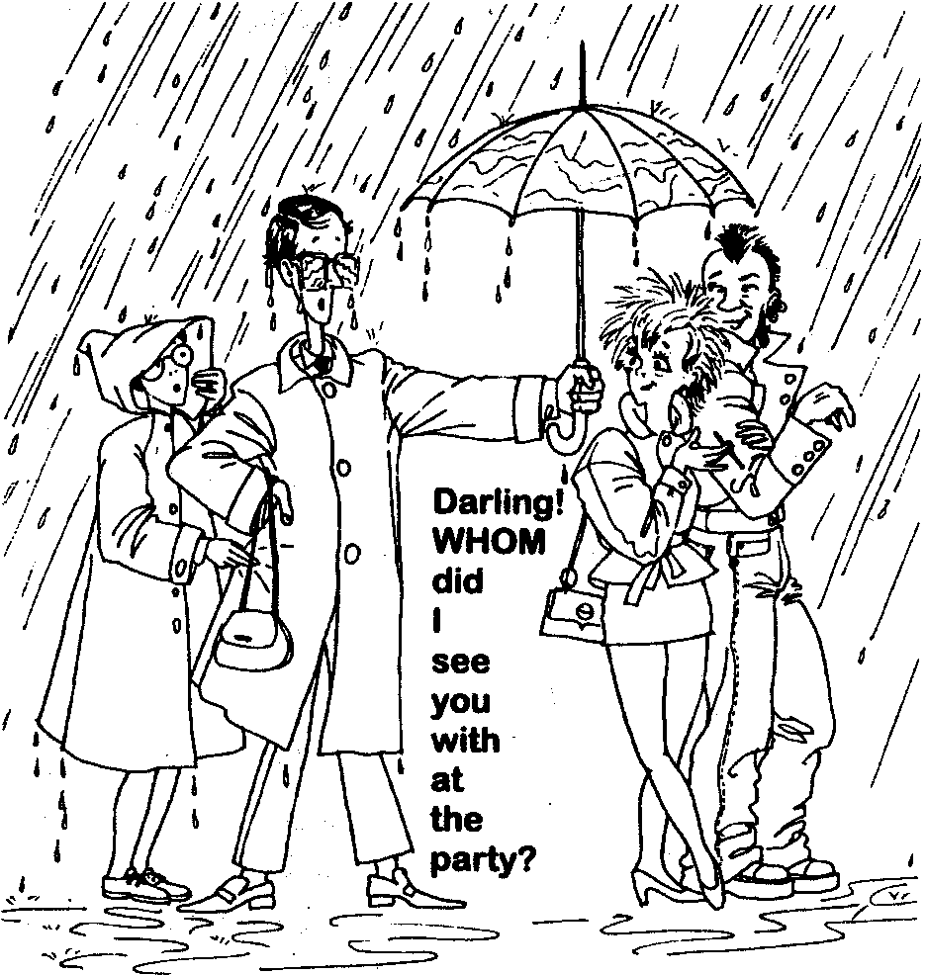
Yesterday from 5 till 5.30 p.m.Tom and Ann/protect against the rain / the umbrella
…Tom and Ann were being protected..

Slide 15
PASSIVE VOICE
be + V3 or V ed
 | Simple | Progressive | Perfect | P.P
Future | Shall/will be + V3
Present | Am/is/are V3 | Am/is/are + +being+V3
Past | Was/were V3 | was / were + being+ V3
Shall/will have + V3
+ to be + V3
__________________________
Shall/will have been + V3
The Tretyakov Gallery will have been opened
by the 3rd
of June.

Slide 16
PASSIVE VOICE
be + V3 or V ed
 | Simple | Progressive | Perfect | P.P
Future | Shall/will be + V3 |  | Shall/will have been +V3
Present | Am/is/are V3 | Am/is/are + +being+V3
Past | Was/were V3 | was / were + being+ V3
Have/has + V3
+ to be + V3
________________________
Have /has + been + V3
The British Museum was founded in 1753 .

Slide 17
PASSIVE VOICE
To be + V3 or V ed
 | Simple | Progressive | Perfect | P.P
Future | Shall/will be + V3 |  | Shall/will have been +V3
Present | Am/is/are V3 | Am/is/are + +being+V3 | Have / has been + V3
Past | Was/were V3 | was / were + being+ V3
SHE or He Or She has + been + V3or V ed
I , we, you, they +have+ been + V3or V ed
The room has been just cleaned by Tom.

Slide 18

Let’s practise!

Slide 19
Not long ago the key/lose/ Jack

Slide 20
PASSIVE VOICE
be + V3 or V ed
 | Simple | Progressive | Perfect | P.P
Future | Shall/will be + V3 |  | Shall/will have been +V3
Present | Am/is/are V3 | Am/is/are + +being+V3 | Have / has been + V3
Past | Was/were V3 | was / were + being+ V3 | Had been + V3

Slide 21
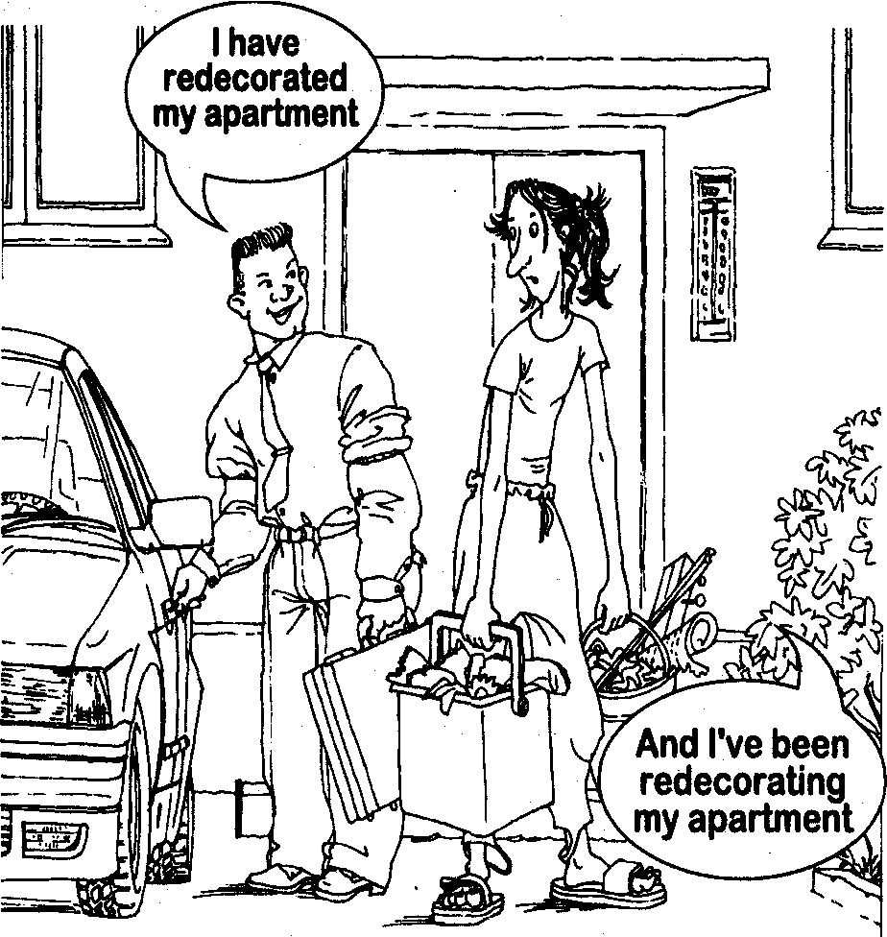
PAY ATTENTION
I have redecorated my apartment.
The apartment has been redecorated by me.
THE SUBJECT AND THE OBJECT REPLACED EACH OTHER

Slide 22
We have learned ,that Passive Voice is everywhere.
Мы доказали, что употребление страдательного залога –явление частое.

Slide 23

GOOD LUCK!

