Slide 1
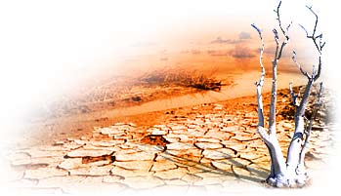
School Conference
“We and Our Environment”
Participants:
Gymnasium 4
Gymnasium 1
Gymnasium 48
Lyceum 1
April, 2007

Slide 2
Agenda
Scientists and Security Council on Global Warming(Kristina Snigiryova);
Mapping the World(Diana Smetanina);
Striking evidence of Climate changing
(Diana Sedlyaruk);
Discussion .

Slide 3
The Security Council and Scientists on Climate Change

Slide 4
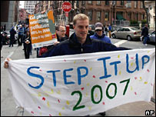
The Security Council is holding its first ever debate on climate change
The debate was initiated by Britain
It concentrates on the risks that climate change could pose to world security

Slide 5
Scientists about our environment
The report states that the observed increase in the global average temperature was “very likely” due to man-made greenhouse gas emissions
It’s the second in a series of IPCC reports coming out this year, together making up its fourth global climate assessment

Slide 6
M A P P I N G
T H E
W O R L D

Slide 7
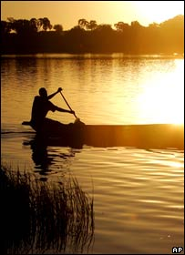
A F R I C A
Some regions are likely to experience the lack of water
The rise of sea level
The rise of the temperature

Slide 8
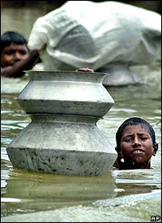
A S I A
Flood
The increasing of hunger risk
The rising temperature of water can produce the cholera virus

Slide 9
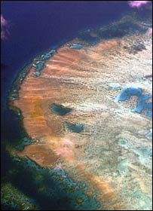
AUSTRALIA AND NEW ZEALAND
An increased risk of storms and flooding
Greater warming

Slide 10
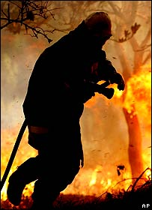
E U R O P E
Health risks due to heat waves are expected to increase
Forest productivity is expected to fall
By 2020, most areas of Europe are likely to see an increased flood risk

Slide 11
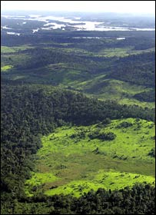
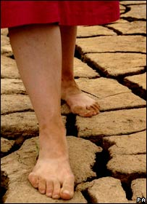
LATIN AMERICA
Species extinctions
Drought
The lack of water

Slide 12
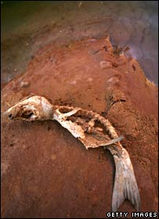
NORTH AMERICA
Forest fires are likely
Rising sea levels
Population growth in coastal areas

Slide 13


ARCTIC AND ANTARCTICA
Melting of ice
Changes to natural ecosystems can cause the migrating of animals

Slide 14
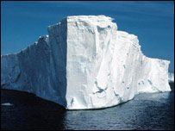

CLIMATE CHANGES
The Earth is getting warmer
Global surface temperatures have increased about 0.6°C (plus or minus 0.2°C) since the late-19th century, and about one half degree F (0.2 to 0.3°C) over the past 25 years (the period with the most credible data)
water and food could help turn peaceful competition into violence

Slide 15
EFFECTS
Within last 160 years concentration of carbon dioxide has greatly increased in the planet’s atmosphere
Every year the atmosphere is polluted by about 1000 tons of industrial dust and other harmful substances
1993: 357.04 ppm
1994: 358.88 ppm
1995: 360.88 ppm
1996: 362.64 ppm
1997: 363.76 ppm
1998: 366.63 ppm
1999: 368.31 ppm
2000: 369.48 ppm
2001: 371.02 ppm
2002: 373.10 ppm
2003: 375.64 ppm
greenhouse gases such as CO₂ change what we call "the thermal balance of the atmosphere" that leads to global warming
After 25-40 years the amount of carbon dioxide will double, since the volumes of organic fuel, burnt by us, increase annually

Slide 16
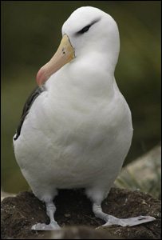
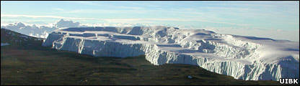
NATURE'S
SUFFERINGS
Unchecked climate change could force up to 72 per cent of bird species in some areas into extinction
Even a small change in temperature can destroy coral reefs forever
Recent concerns that climate warming would rob Mount Kilimanjaro of all its glaciers within 20 years are overly pessimistic
the drying of the East African climate around Kilimanjaro may itself be a regional impact of global climate change

Slide 17
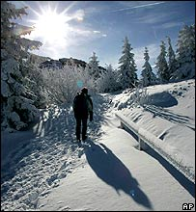
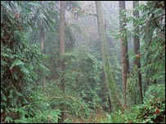
PLANTS
Planting trees in snowy areas may worsen global warming as their canopies absorb sunlight which would otherwise be reflected by the snow, a study says

Slide 18
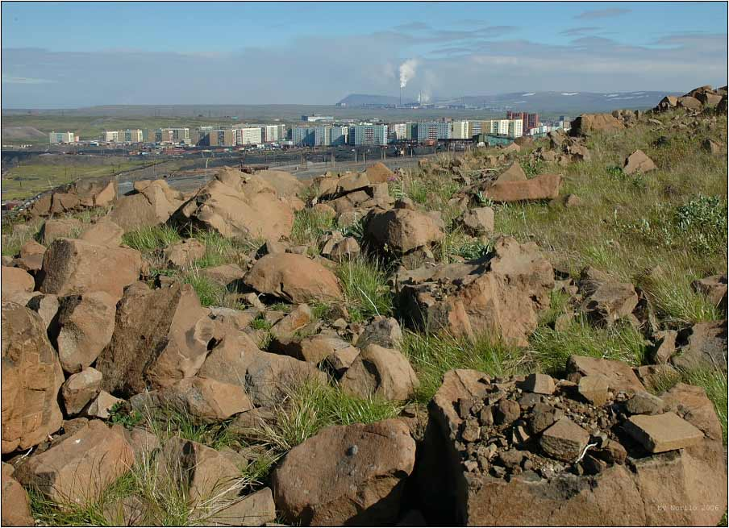
OUR PROBLEMS
Large cities with thousands of steaming, polluting plants and factories can be found nowadays all over the world
Developing countries are already suffering the consequences of climate change with the increased frequency and intensity of severe climate events
We must improve what we are doing!!!

Slide 19
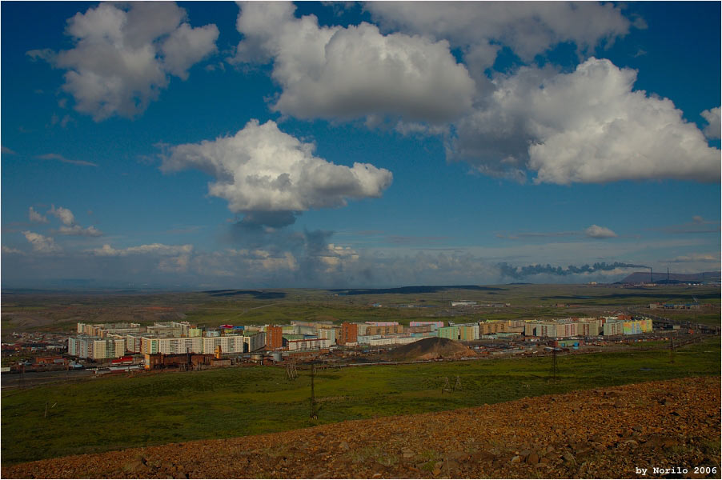
SOLUTIONS
find a new style of life compatible with nature conservation on the global level
search for a new balance between the nature, technology and culture
In particular:
lower carbon economy
solar energy technologies
recycling of disposable dishes and tableware used for fast-food catering

Slide 20




What can I do about climate change?
Share your concerns
Find people near you
Make a difference
in your neighbourhood

Slide 21
Quiz
1. Scientists representing the UN's International Panel on Climate Change predict that by the end of the century temperatures could rise by as much as:
3°C
5°C
5.8°C √
6.5°C
2. What has been the average global temperature change over the last 100 years?
An increase of about 2°C
An increase of about 1°C
An increase of about 0.5°C √
A decrease of about 1°C
3. The greenhouse effect refers to:
A global temperature increase due to the number of greenhouses being built, especially in the industrialised world
A naturally-occurring process which keeps the Earth warm enough for life to be possible √
The increased amount of carbon dioxide and other gases that humans have emitted in the last 100 years, which contribute to global warming
The ozone layer, which allows heat to pass through to the Earth, but not to escape
4. By how much has sea level risen in the last century?
  0 - 5 cm
  10 - 15 cm
  15 - 20 cm √
  25 - 35 cm
5. What is the Earth's average temperature?
    11°C
    15°C √
    19°C
    22°C

Slide 22
6. Carbon dioxide accounts for what percentage of greenhouse gas emissions:
      25%
      34%
      63% √
      78%
7. In the United States, average greenhouse gas emissions per person in 1995 were:
        2 tonnes
        3.5 tonnes
        5.2 tonnes
        5.2 tonnes √
8. In Switzerland, average greenhouse gas emissions per person in 1995 were:
        2 tonnes √
        3.5 tonnes
        5.2 tonnes
        6.6 tonnes
9. The Kyoto protocol commits countries in the developed world to cut greenhouse emissions by 2012 by:
5% below 1990 levels √
25% below 1990 levels
30% below 1990 levels
60% below 1990 levels
10. Scientists say if we continue to emit greenhouse gases at current rates, over the next 80 years there is likely to be:
A substantial dieback of tropical forests, especially in South America and southern Africa
Increased cereal yields in North America, China and Argentina
Less water in rivers in Australia, India, Europe and the Middle East
All of the above √

