Slide 1
Prepared by the student group CSSE-113K

Slide 2
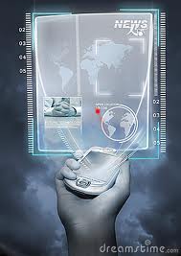
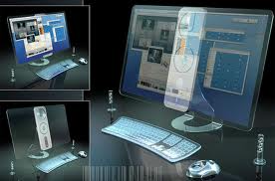
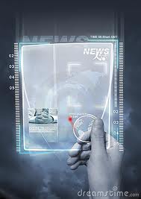
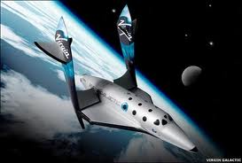
Future Technologies

Slide 3
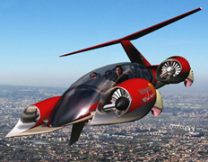
Flying Machine
The inventor of this extraordinary vehicle does not like his work called "flying machine". Instead, he prefers to describe his ingenious inventions term roadable aircraft (fitted to the road plane).
According to the creator Carl Dietrich, a student at Massachusetts Institute of Technology, Transition model can be used as an air taxi flight between 4,8 thousand small airports in the U.S..
Now he and his team have developed a scaled-down version of the 5-fold apparatus for testing in a wind tunnel. They hope to build a prototype for the next two years. First flight of the Transition is scheduled for 2010.

Slide 4
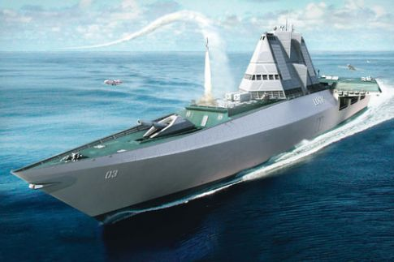
The ships of the future
It is difficult to talk about what kinds of wars the future will bring, but one thing is certain: Robots will be involved in most battles. In fact, already involved. Last year, the unmanned aircraft (aircraft) flew 258,502 hours, compared with 27,201 in 2002.
The cost of unmanned aerosistems U.S. military is expected to reach 3.76 billion by 2010.
Robot Wars, a long time
remained the lot of science fiction,
has now become a reality.
UXV can effectively served by
a minimum crew. Warships have
crews of hundreds of people, UXV
will manage a team of 60 sailors,
which is sufficient for the
organization of three-shift watch
and in addition - to service
unmanned aircraft.

Slide 5
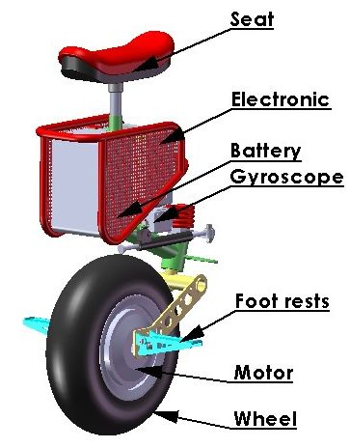
Transportation of the future
Transport in the future everyone imagines different ways - from the drop-like transparent modules were being borne by monorail, and to a portable missile. Many talk that Segway and the sedentary option - this is the future of transport but not agree with them gadget-maker unicycle eniCycle.

Slide 6
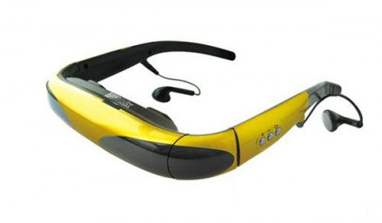
Glasses of the future
Latest glasses iTVGoggles ITG-Vidix will be available to you 50 "screen, as well as they built an SD card slot for 32GB.

Slide 7
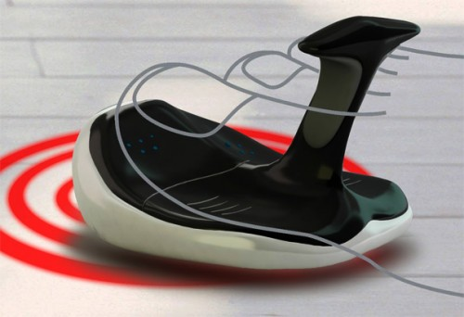
Computer mouse of the future.
Toe Mouse - it's kind of a computer mouse, which is designed for people with upper limb defects. To use it, you just put it on the first two toes and do - the same as the normal mouse on a special mat.

Slide 8
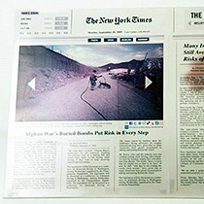
The newspaper of the future
10 years later, and maybe even less progressive people forget about paper newspapers - they will be replaced by electronic interactive sensor newspaper of the future. Their concept has already been submitted - The Page displays text, images, and is divided into the usual newspaper us columns. The Page is designed to combine the merits of print and online media. Thickness of this device with a sheet of plain paper. Despite the fact that it entered into a number of functions, it is as flexible as paper - it can be folded several times and put in your pocket or folder.

Slide 9
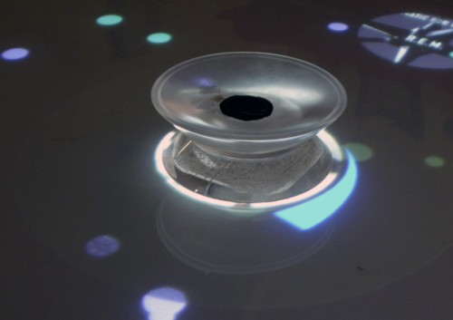
Table of the future
Amusity - this is a new creation from the creator and Pepper Knuckles Music Blocks, Idan Arbel. This is a kind of multimedia coffee table. And all your music and video collection
will be on hand. You will
be able to play music,
videos, as well as find
information about
the artist.

Slide 10
Thank you for your attention!

