Slide 1
Professions
Prezentacii.com

Slide 2
a doctor

Slide 3
a pilot

Slide 4
a dentist

Slide 5
an engineer

Slide 6
+
a nurse

Slide 7
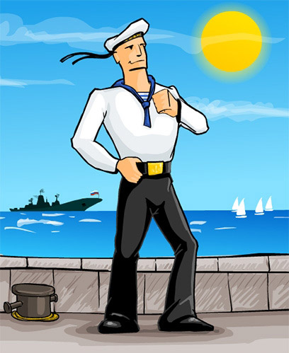
a sailor

Slide 8
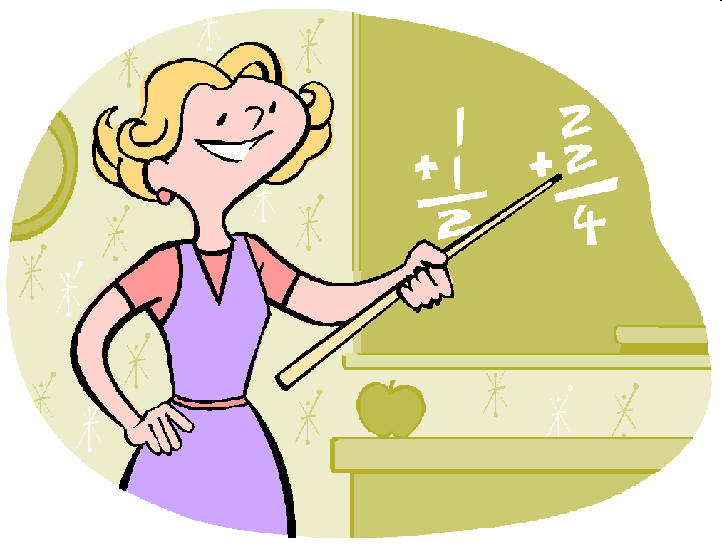
a teacher

Slide 9
an artist

Slide 10

a singer

Slide 11
a driver

Slide 12
a worker

Slide 13
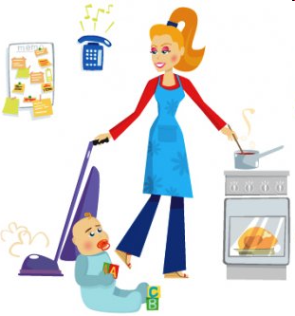
a housewife

Slide 14
a dancer

Slide 15
a builder

Slide 16
an officer

Slide 17
a player

Slide 18
What do you want to be?

Slide 19
I am a pupil.
am
I am not a pupil.
Am I a pupil?
He is a doctor.
to be
is
He is not a doctor.
Is he a doctor?
They are pilots.
are
They are not pilots.
Are they pilots?

Slide 20
Let’s do some exercises!

Slide 21
Find the mistakes and translate the sentences (Найди ошибки и переведи предложения):
I is a dancer. He am not a runner. We is singers. Is I a builder? I are not a teacher. She am not an artist. Am you a driver? They is not swimmers.
1. I am a dancer.
2. He is not a runner.
3. We are singers.
4. Am I a builder?
5. I am not a teacher.
6. She is not an artist.
7. Are you a driver?
8. They are not swimmers.

Slide 22
Fill in the gaps with the correct forms of to be. Translate the sentences (Вставь глагол to be в нужной форме и переведи предложения):
am
I …… a doctor. They …… artists. …… you a dentist? …… I an engineer? I …… not an officer. …… she a housewife? My mother …… not an economist. We ……… not pupils.
are
Are
Am
am
Is
is
are

Slide 23
It’s time to have a rest!

Slide 24

Our letters!

Slide 25
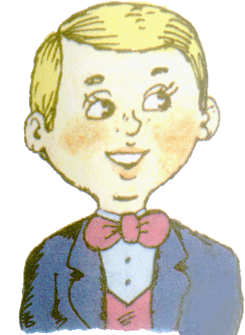
Good morning,
Boys and Girls!
My name is Paul. I’m 8. I’m from Great Britain.
I want to tell you about my Mummy!

Slide 26
Text 1
Find the mistakes
(Найти ошибку):
My Mummy is from Canada.
Her name is Jane.
She has got two children, two daughters.
She likes to run and jump.
The children like to swim.
She is a singer.
1. My Mummy is from Great Britain.
2. Her name is Gloria.
3. She has got three children, three sons.
4. She likes to sing and dance.
5. The children like to sing and dance, too.
6. She is a doctor.

Slide 27
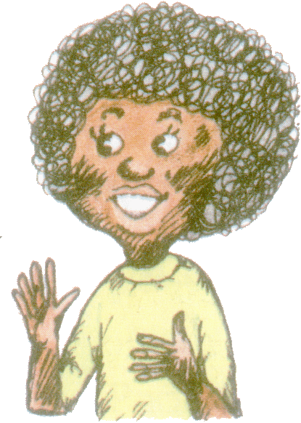
Good morning, Boys and Girls!
My name is Karen. I’m 7. I’m from Africa.
I want to tell you about my Mummy!

Slide 28
Text 2.
Complete the sentences (Закончи предложения):
My Mummy is from …
Her name is ….
She has got … children.
She …..… them all.
She is a …
She likes to ........ and …
She is ...
Africa
Nora
5
loves
dentist
draw
cook
fine

Slide 29
Home task
(домашнее задание):
P. 61, ex.11 (Стр. 61, упр. 11)

Slide 30
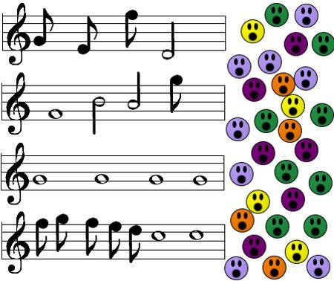
Let’s sing a song!
I Am a Pupil
I am a pupil,
He is a pupil,
She is a pupil, too.
I am not a dentist,
I am a pupil
And I like you.

