Slide 1


How to Write a CV

Slide 2
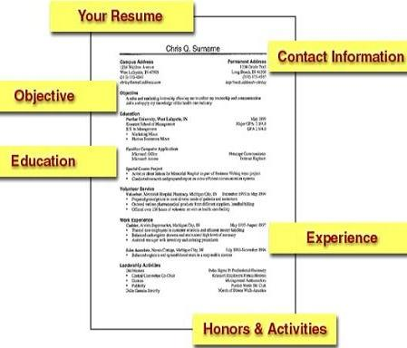
Usually a CV is divided into several parts and can include:
Personal information (Личная информация)
Objective (Цель)
Education (Образование)
Work Experience and Employment (Профессиональный опыт)
Positions of responsibilities (социальная активность)
Special skills (Специальные навыки)
Interests (Интересы)
References (Рекомендации)

Slide 3
Personal Information
Provide the employer with personal information so they can contact you easily. Be sure to include your name, address, phone number, email, and fax number, if available.
Ivan I. Ivanov
198, Zelenaya Street, apt. 85
St Petersburg, 191194, Russia
Phone: +7 812 273 10 50
Date of Birth: 25.08.1970
Marital Status: married

Slide 4
Objective
This is statement of what you actually want to do. If you apply for a job, you can write " to obtain a position in... , where I can use my skills in…".
You should show what you can do for the company more than what the company can do for you.
Obtain employment in the field of public relations that will allow me to use my ability to work with people and take advantage of my knowledge of English.

Slide 5
Education:
Give places of education where you have studied - most recent education first.
Include any special project, thesis, or dissertation work.
Pre-college courses (high school, etc.) should then be mentioned, including grades.
St.Petersburg State University
1988-1995 Diploma in English and French. Qualified as English interpreter.
1977-1988 School №31, Penza, Russia.

Slide 6
Working Experience
Include all your work experience in reverse chronological order.
Include the following for every description:
- Title of the position
- Name of the organization
- Location of work
- Date of employment
Stress your best and most relevant achievements.
Working as a chief specialist in Insurance Co.Rodina Ros.
April 1995-to present
Duties: schedules of meetings, appointments and recording of the personnel, interpreting and translation of documents.

Slide 7
expanded - расширил
grouped - сгруппировал
headed - возглавлял
improved - улучшил
increased - увеличил
installed - установил
invented - изобрел, ввел в работу
promoted - продвигал
purchased - закупал
raised - поднял, увеличил
replaced - заменил
stimulated - стимулировал
strengthened - усилил
supported - поддерживал
systematized - систематизировал
won - победил
wrote - написал
Use these words describing your working experience:
advanced - продвигал
analyzed - анализировал
assisted - помогал
carried out - выполнил
changed - изменил
classified - классифицировал
completed - выполнял
conducted - осуществлял
controlled - контролировал
cooperated - сотрудничал
coordinated - координировал
corrected - исправлял
created - создавал
detected - вычислял
developed - развивал
discovered - обнаружил
established - основал

Slide 8
Position of Responsibility
List all awards and honors you have achieved in reverse chronological order.
Include achievements from all areas of your life – academic, sporting, within the community, etc.
Publications, Conferences, Presentations:
They can provide a significant point of difference between you and other candidates for positions where such skills are both valued and relevant.
Head Basketball Manager, St.Petersburg State University Basketbal Team
Communicated with coaches, managers, players and trainers;
Coordinated duties and responsibilities for all managers;
Completed and maintained paperwork on the team.

Slide 9
Special Skills
List here all the languages you speak, with a one-word description of your knowledge of that language: conversational, intermediate, advanced, and fluent.
List any certificates and/or results like TOEFL scores, with date.
Mention your computing skills (e.g. "good working knowledge of MS Access and Excel, basic web page design skills“, etc.)
English: Fluent reading, writing and speaking ability. Qualified as interpreter and translator.
French: Good reading and translating ability.
Computer skills: Advanced PC user (MS Office,
MS Access, Navision, Lotus Notes, Consultant Plus, Garant).

Slide 10
Interests
Show a range of interests
Hobbies that are a little out of the ordinary can help you to stand out from the crowd
Any interests relevant to the job are worth mentioning
Any evidence of leadership is important to mention (captain or coach of a sports team, course representative, chair of a student society, scout leader|)
Dancing: Dancer in a professional dancing group.
Swimming: Winner of regional and town competitions.

Slide 11
These words can be used when you write about your responsibilities, qualities and skills:
accurate - пунктуальный, точный
active - активный
adaptable - приспосабливаемый
broad-minded - с широким кругозором
competent – компетентный
conscientious - добросовестный
creative - изобретательный
dependable - заслуживающий доверия
determined - решительный
diplomatic – дипломатичный
discreet - осмотрительный
efficient - эффективный
energetic - энергичный, активный
enterprising - предприимчивый
enthusiastic - полный энтузиазма
experienced - опытный
fair - честный, справедливый
firm - твердый, непоколебимый
honest - честный
loyal - лояльный, верный,
преданный
positive - позитивный
reliable - заслуживающий доверия
resourceful - находчивый,
sense of humor - чувство юмора
sensitive - чувствительный
sincere - искренний
successful - успешный
tactful - тактичный
trustworthy - надежный

Slide 12
References
Write 'References available on request' if you prefer that the employer asks your permission before writing or ringing them up.

Slide 13

Good luck!

