Slide 1
”Present Simple”

Slide 2
Содержание
Употребление
Образование
Примеры
Упражнения

Slide 3
Present Simple
Постоянные, повторяющиеся действия
Характеристики, обычаи, привычки
Законы природы и общества
Действия, происходящие сейчас, которые обозначаются глаголами, не употребляющимися в Progressive
Сказуемое в придаточных предложениях времени и условия

Slide 4
Образование
утвердительные
V; He/she/it Vs
вопросительные
отрицательные
Do … V?
Do not V
Does he/she/it V?
He/she/it does not V

Slide 5
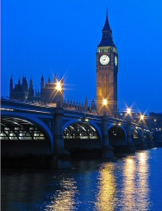
Примеры
Nick lives in London.
I live in Rostov.
I don’t live in London.
He does not live in Rome.
Where do you live?

Slide 6
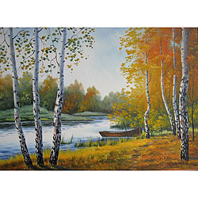
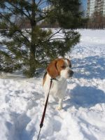
Practice
Do
… you like spring?
… you like winter?
Do
No, I …
don’t.
Yes, I …
do

Slide 7
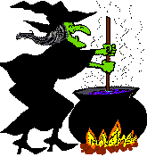
Answer the questions
Does she like cooking?
Does she cook well?
Do you cook well?
Does she look good?
Do we believe her?

Slide 8
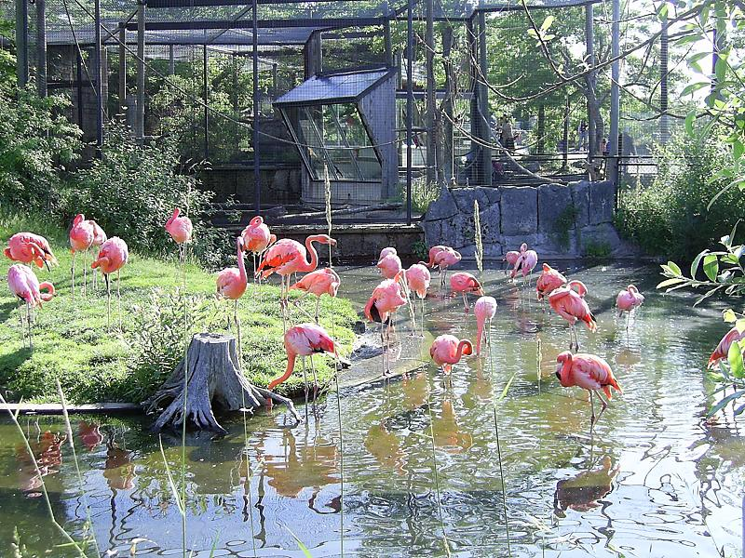
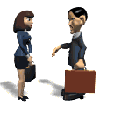
Where do they go on Saturdays?
On Saturdays they go to the zoo.

Slide 9
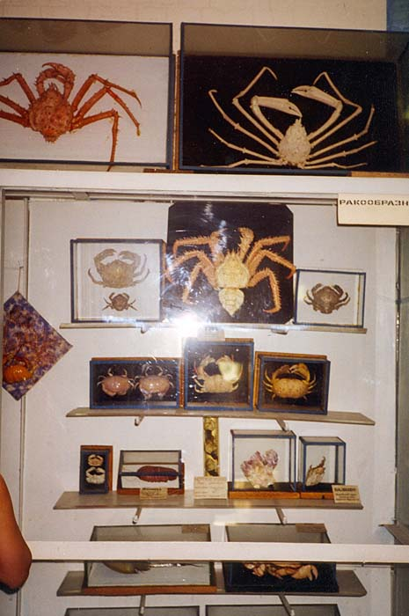

Where does she go on Sundays?
On Sundays she goes to the museum.

Slide 10
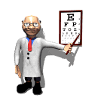
Where does he work?
Does he work at school?
No,he doesn’t.
Does he work at a hospital?
Yes, he does.

Slide 11



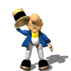
Choose the correct answer
help
She … the ball every day. (play/plays)
She … … other toys. (doesn’t play/doesn’t plays/don’t play)
I … only in the evening. (cook/cooks)
I … … in the morning. (doesn’t cook/don’t cook)
They always … in the afternoon. (meet/meets)
They … meet in the evening. (don’t/doesn’t)

Slide 12
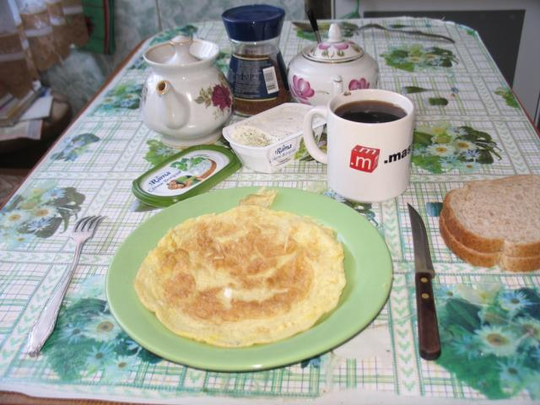
Ask and answer questions:
help
What …you usually have for breakfast?
… you … tea or coffee?
… you … bacon and eggs?

Slide 13
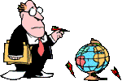
Ask and answer questions:
help
Where … he work?
What … he teach?
… he like his job?

Slide 14
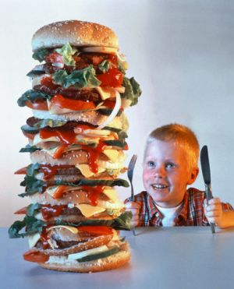
help
Ask your questions and answer them:
Does …
What …
Where …
Why …
With whom …
Do you …

Slide 15
The END

