Slide 1

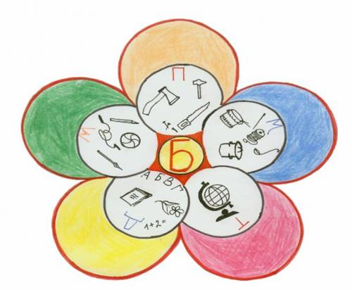
FAMILY RELATIONS.
Prezentacii.com

Slide 2
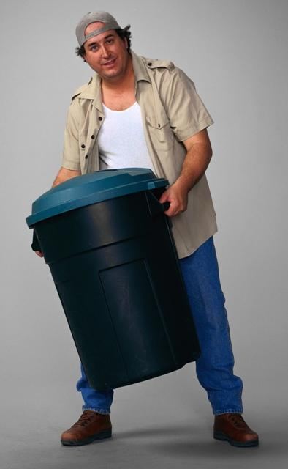
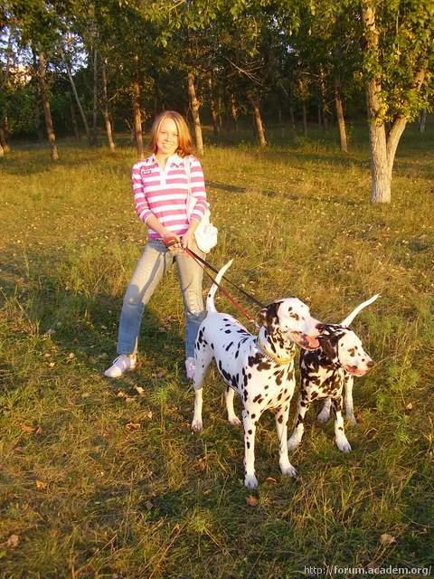
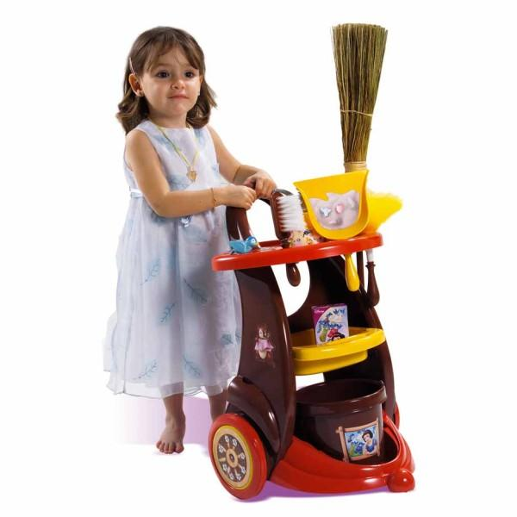

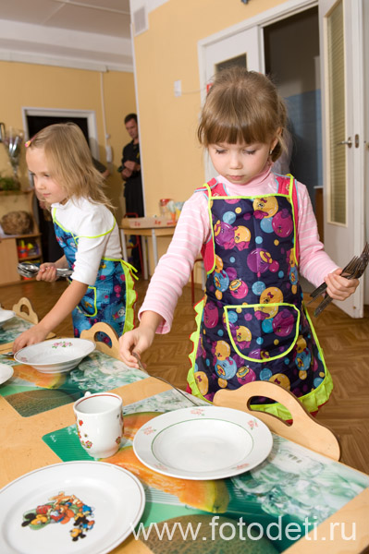
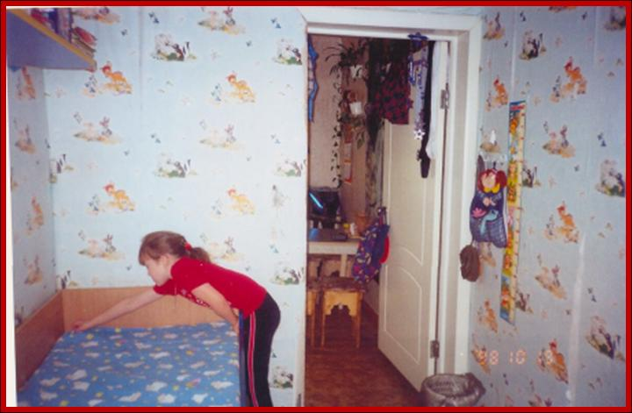
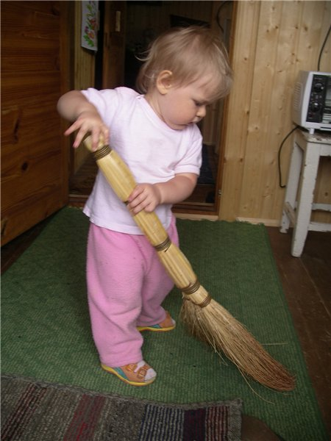
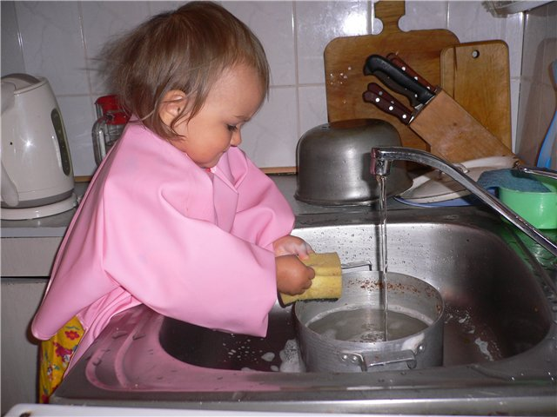
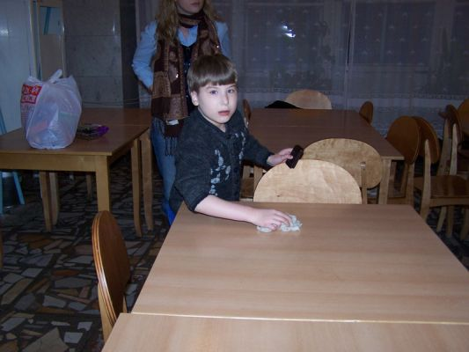
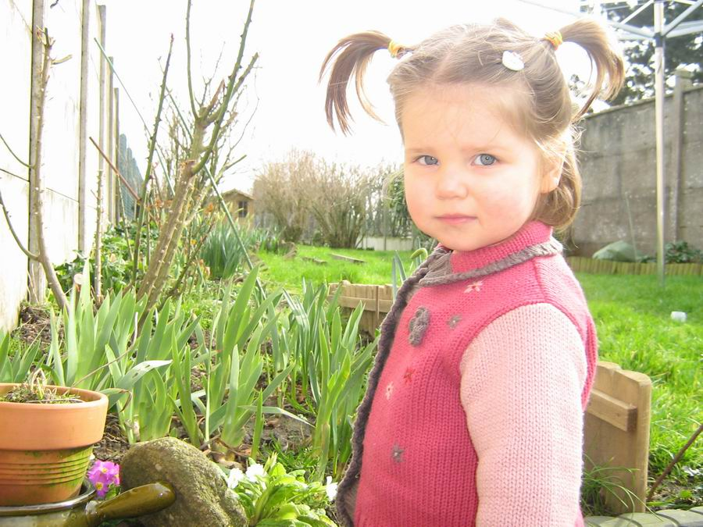
RESPONSIBILITIES.
MAKE A BED
SWEEP THE FLOOR
WASH UP
SET THE TABLE
CLEAR THE TABLE
DO HOMEWORK
TAKE OUT THE RUBBISH
HELP IN THE GARDEN
WALK WITH A PET
CLEAN THE FLAT

Slide 3

IDEAL PARENTS.
Parents must give their children more love.
Parents must talk to their children more often.
Parents must try to understand their children.
Parents must give their children more freedom.
Parents must help their children with problems they have at school.
DO YOU AGREE? WHAT IS YOUR OPINION?
I think parents must…
To my opinion parents must not …
My parents always … me.

Slide 4
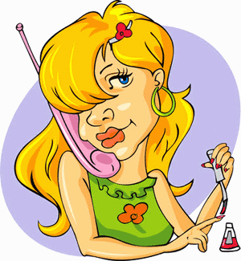
IDEAL CHILDREN.
Children must do their homework.
Children must wash up.
Children must set the table before dinner.
Children must clear up the table.
Children must make their beds.
Children must help in the garden.
Children must take out the rubbish.
Children should love their parents.
What are your responsibilities at home?
I … at home.
I don’t … at home.
My parents say I must …
My parents say I should …

Slide 5
YOUR JOBS AT HOME.
Past Simple | Present Simple | Present Perfect | Future Simple
V2 did (делал) | V, Vs do, does (делаю) | have, has + V3 have, has done (сделал) | will + V will do (сделаю, буду делать)
Yesterday Last Ago | Often Every day Usually Always | Already Just | Tomorrow
Put in the verbs into the correct form.
I (take) out the rubbish already.
I (wash) up yesterday. Today is your turn.
My father usually (walk) our dog in the morning.
Steve (set) the table for lunch tomorrow.

Slide 6
YOUR JOBS AT HOME.
Past Simple | Present Simple | Present Perfect | Future Simple
V2 did (делал) | V, Vs do, does (делаю) | have, has + V3 have, has done (сделал) | will + V will do (сделаю, буду делать)
Yesterday Last Ago | Often Every day Usually Always | Already Just | Tomorrow
Fill in the chart.
Tuesday | Saturday | Friday morning | Every Sunday
I … yesterday. | I … tomorrow. | I … already. | I usually …

Slide 7
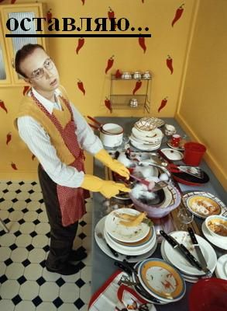
HOMETASK.
To make up a story
“My Responsibilities at Home”.
(8 – 10 sentences)
To learn the story by heart.

Slide 8



GOOD JOB!
Choose a smile for your own according to your work at the lesson.
Be objective!
I did all my best! Excellent!
I tried as much as I could. Rather good!
I should learn English better!
Not very well…

