Slide 1
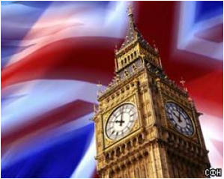
How many Houses does
the British Parliament
consist of?

Slide 2
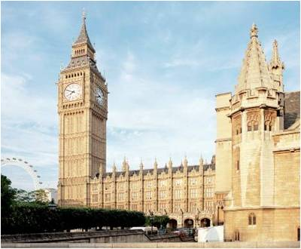
Цели урока
Ознакомимся с политическим устройством Великобритании
Закрепим изученный страноведческого материала
Познакомимся с лексикой по теме

Slide 3
Этапы урока
Организационный
Речевая разминка
Проверка домашнего задания
Аудирование, работа с текстом по теме
Изучение нового страноведческого материала
Закрепление изученного страноведческого материала
Подведение итогов урока, формулировка домашнего задания

Slide 4

Речевая разминка
Работа с новыми словами по теме урока
To tease – дразнить
To elect – избирать
To vote – голосовать
To approve – одобрять
To inherit – наследовать
To represent – представлять (кого – либо)
A peer - пэр
Personal achievements – личные достижения
Law - закон
State – государство
Common– община
To consist of– состоять (из чего – либо)
At least – по меньшей мере
To be called- называется

Slide 5
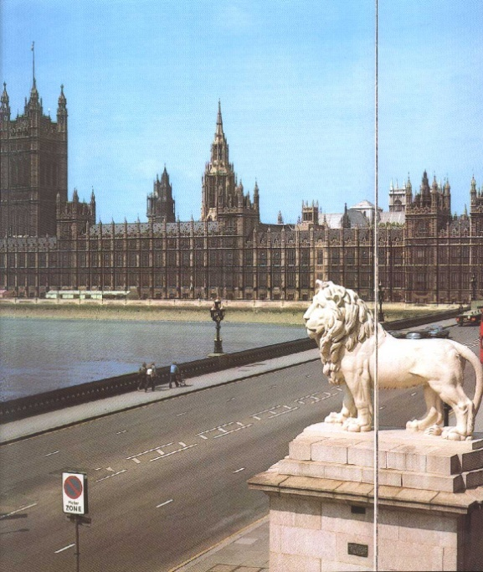
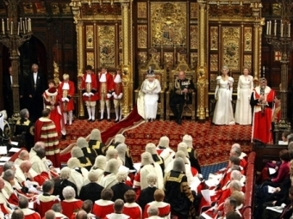
Parliament – парламент
House of Lords – палата Лордов
Prime Minister – премьер-министр
House of Commons – палата общин

Slide 6
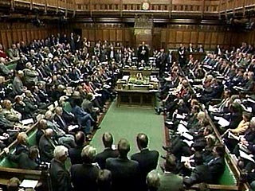
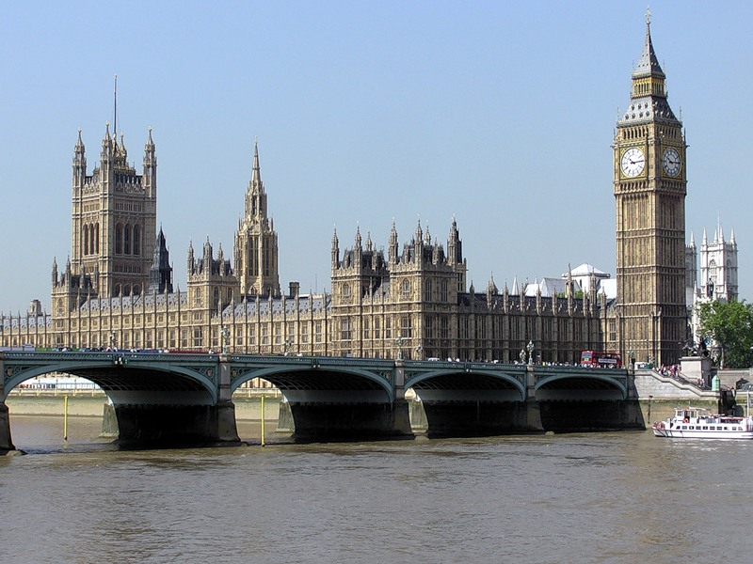
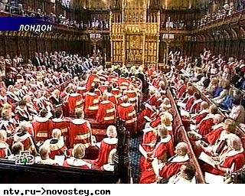
Ex. 3 p. 50

Slide 7
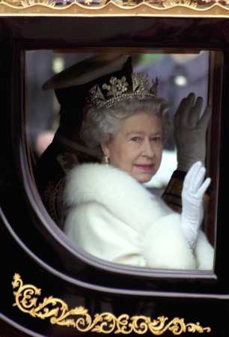
The Queen is the head of state.
Nowadays the Queen is Elizabeth II.
Before a bill becomes law the Queen has to say
“La Reine le Veut” - “The Queen wishes it”

Slide 8
How many Houses does the British Parliament consist of?
The British Parliament consist of two Houses: the Houses of Lords and Houses of Commons.

Slide 9
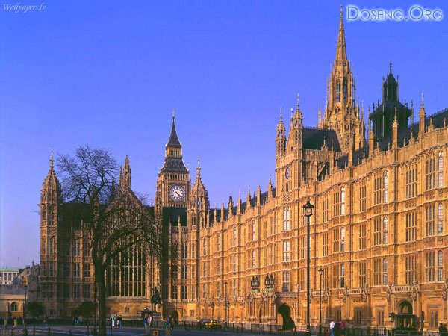
The British Parliament consists of two parts:

Slide 10
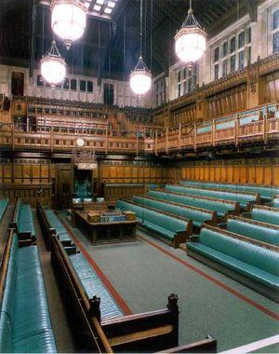
The House of Commons
Members of the House of Commons (MPs) are elected every five years. They represent all the people of the country.

Slide 11
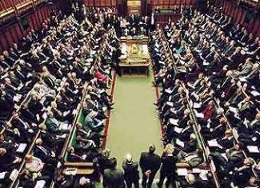
People vote for an MP. And the party which has the most MPs wins the election and forms the government . Their leader becomes the Prime Minister .

Slide 12
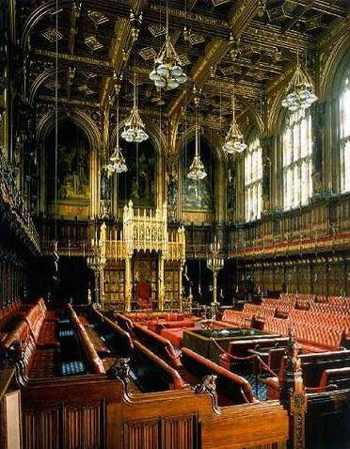
The House of Lords
The House of Lords consists of hereditary peers and life peers.
Hereditary peers inherit their title from their relatives. Life peers get the title for their personal achievements.

Slide 13
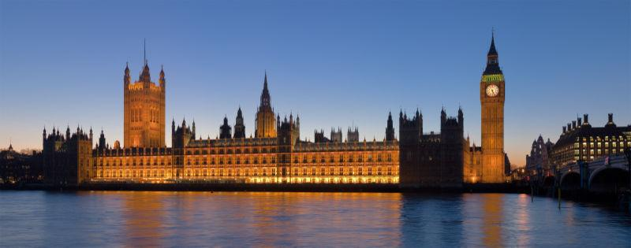
In the House of Lords Ladies and Lords talk about bills before they become laws and sometimes suggest changes to the House of Commons.

Slide 14
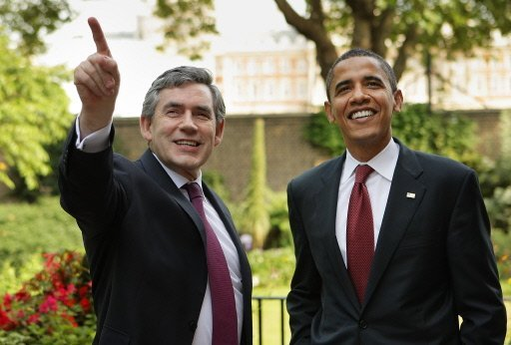
Prime Minister
The Prime Minister is the head of the government in the United Kingdom
Gordon Brown

Slide 15
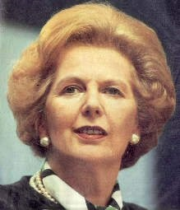
Margaret Thatcher
"The Iron Lady"? Was one of the UK,s most powerful and competent Prime Minister? From 1979 to 1990

Slide 16
Answer the question
Who is the head of state in the UK?
Who is the head of the government in the UK?
How many Houses does the British Parliament consist of?
Which Houses represents the people of Britain?
What are the members of the Houses of Commons called?

