Slide 1
МОУ Манычская СОШ № II
Зерноградского района Ростовской области
Hi , London.
Ученики 11 «а» класса
МОУ Манычской СОШ № II
Учитель: Барсегян Карине Владимировна

Slide 2
Hi , London.
London is «a nation,not a city»,in such a way Benjamin Disraeli described the British capital.

Slide 3
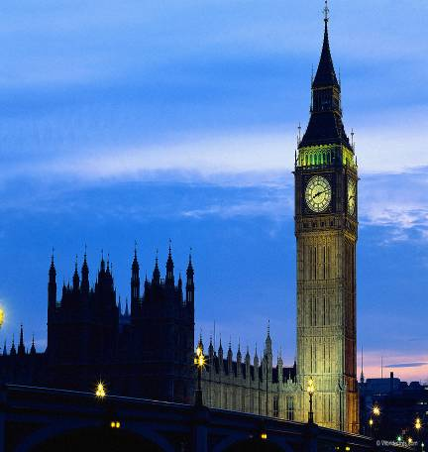
Sights of London
It ‘s a particular and unique capital famous for its size and location, for being the home of the oldest monarchy in the West, by its mixture of commerce and history .

Slide 4
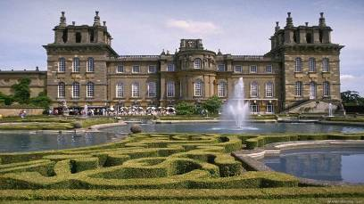
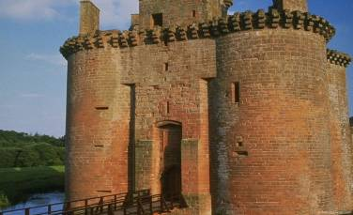
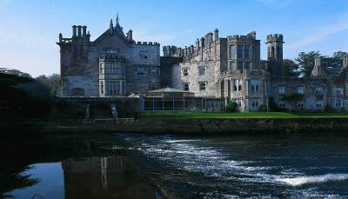
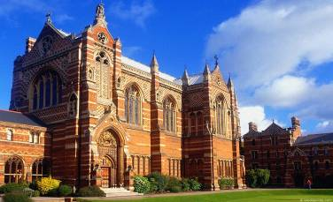
London is famous for its palaces .

Slide 5
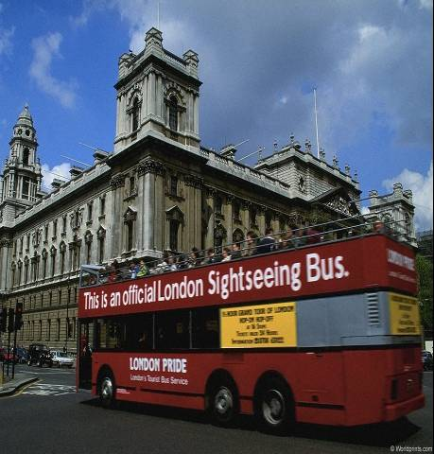
A double-decker bus tour about
London.
The first double-decker was built in 1851. Bus service in London was started in 1829, but the upper deck didn’t have a roof until 1930. The passengers were given raincoats to put on if it started to rain.

Slide 6
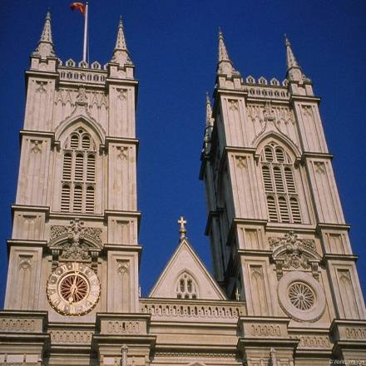
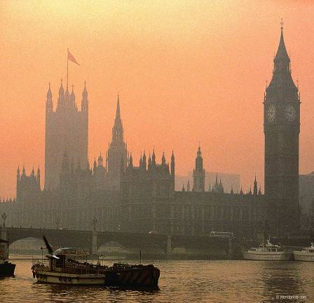
Westminster is the main part of central London.
Westminster Abbey The Houses of Parliament

Slide 7
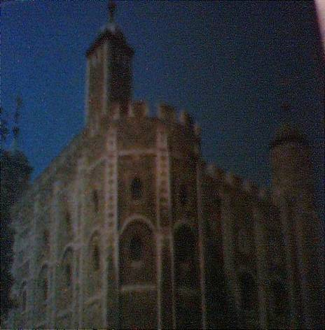
Tower of London-The White Tower
The Tower of London
It was built in the 11 th century . William the Conqueror ordered the building of the great stone tower later called the White Tower.It was a fortress , a palace , a prison , and the King’s Zoo. Now it is a museum .You can see a lot of interesting things in the halls of the White Tower.

Slide 8
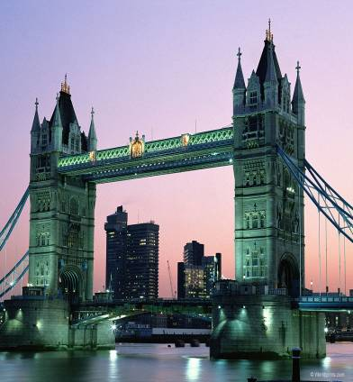
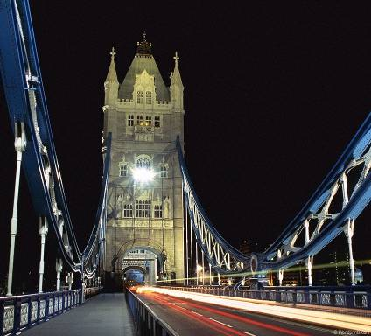
Тема третья
The Tower Bridge
There are about 30 bridges across the river Thames..Tower Bridge is the biggest and the most beautiful of them .It is situated to the east of the Tower of London .
The bridge was built in 1894 and is made of two parts which can be lifted , for ships passing under the bridge.

Slide 9
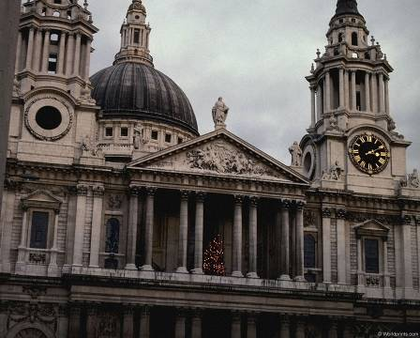
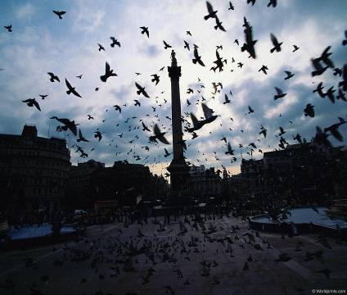
The City of London
The West End
St. Paul’s Cathedral is a beautiful church with many columns and towers . Sir Christopher Wren built the cathedral in the 17 th century about 35 years .
Trafalgar square was so named to commemorate Nelson’s victory over Napoleon at the battle of Trafalgar in 1805. Nelson was killed in the battle but the victory was won .

Slide 10
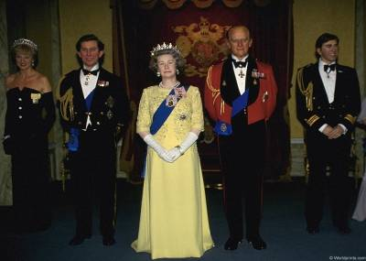
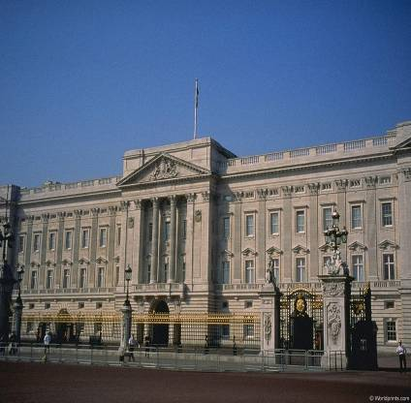
The Royal Family
Buckingham Palace
Buckingham Palace is the official home of the British royal family in London . There are 600 rooms in the palace . One of them is the Balcony Room from which the Royal Family greet the public.

Slide 11
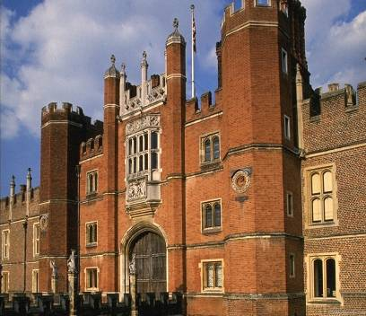
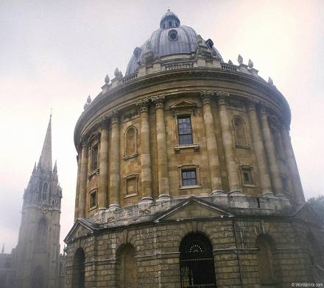
Hampton Court
Saint Paul’s Church
Hampton Court was built in 1512 by Cardinal Wolsey.To please the king Henry , he presented it him .

Slide 12
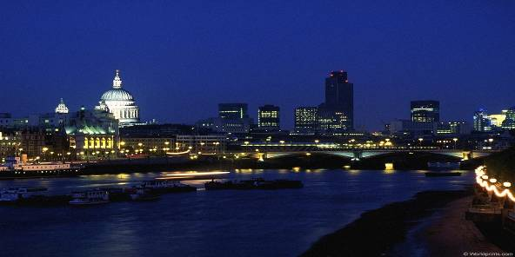
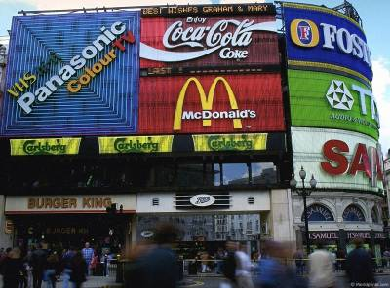
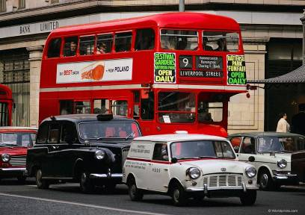
Piccadilly Circus
Oxford street

Slide 13
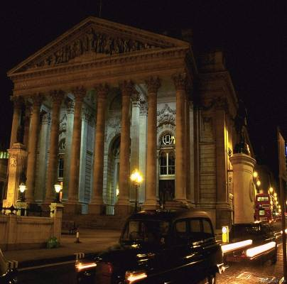
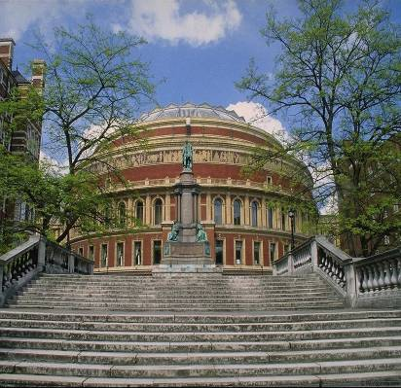
London’s Museums, galleries.
The British Museum
The Royal Albert Hall

Slide 14
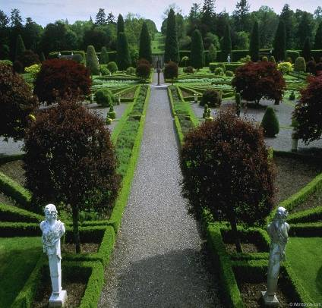
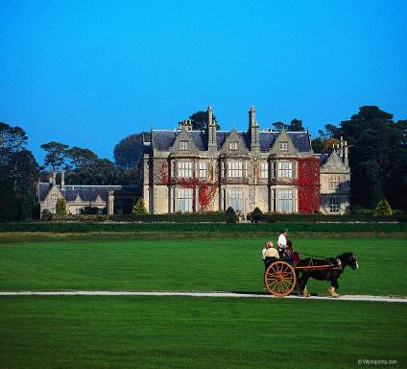
London Parks
London has more parkland than almost any other world capital .
Saint James’s Park
Green Park

Slide 15
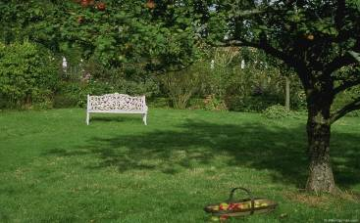
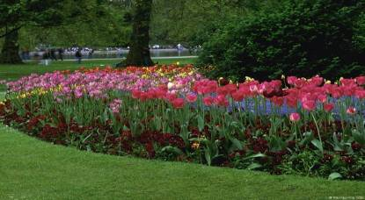
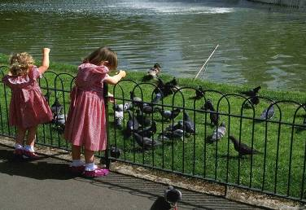
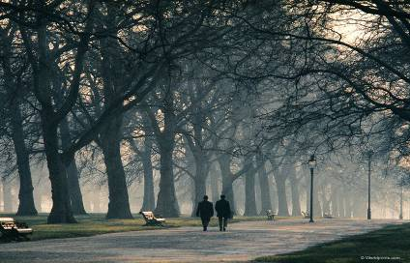
Kensington Garden
Hyde Park

Slide 16
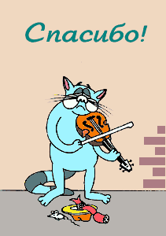
Spot the mistakes
London is the capital of Scotland. It is one of the oldest and largest cities of the world . They say that London is one hundred years old . Now London is a big political , industrial and cultural centre . More than 1 million people live there . London is situated on the river Clyde . The river connects the capital with the sea . London is divided into two parts . Westminster is the heart of business and commercial life . The City is the political centre .

