Slide 1
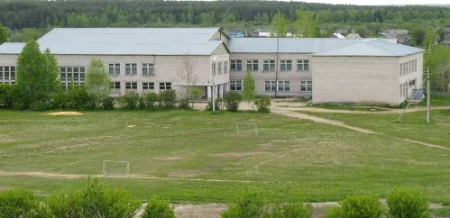
School. School Subjects
Игнатьевская Татьяна Николаевна, учитель английского языка МОУ «Нижнекулойская средняя общеобразовательная школа» Верховажского района Вологодской области

Slide 2
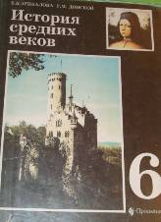


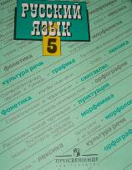

History
Russian
Algebra
Biology
English

Slide 3
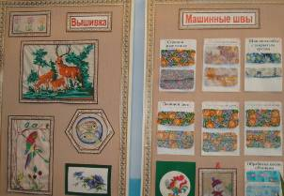





Geometry, Art, Music, Physics, Physical Education, Handicraft, Cooking, Geography, Literature, Information Technology

Slide 4
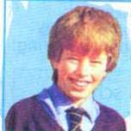
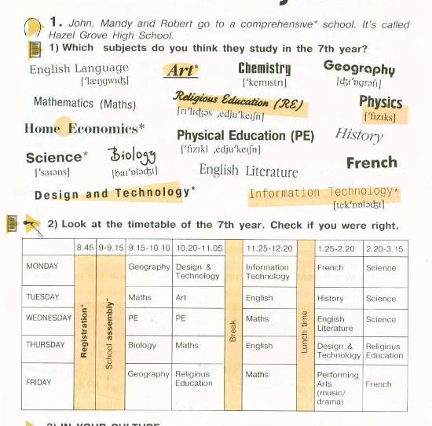
Hazel Grove High School
The exercise is taken from “English- 7” by V. P. Kuzovlev

Slide 5
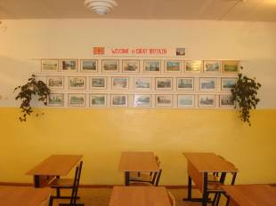
necessary
?
English
?
?
?

Slide 6
easy
useful
difficult
important
interesting
boring
necessary
favourite

Slide 7
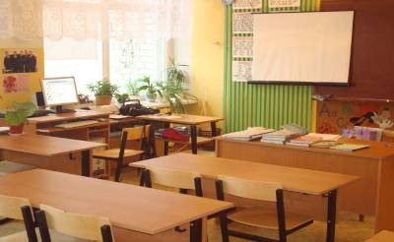
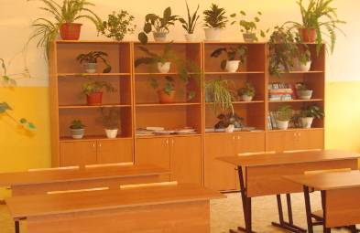
difficult
WHY
favourite
interesting
necessary
boring
useful
T- English is my favourite school subject BECAUSE we learn much interesting at our lessons and the teacher is very good.

Slide 8
Thank you
for the work!

