Slide 1
IMPERATIVES

Slide 2
IMPERATIVES
POSITIVE
1. Go!
2. Go, please!
3. Let` s go!
NEGATIVE
Don` t go !

Slide 3
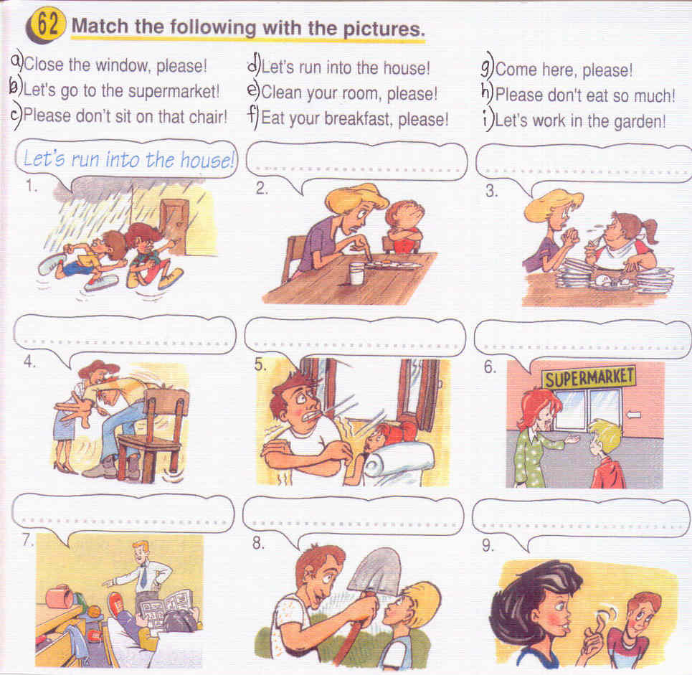

Slide 4
Answers
1. | 2. | 3. | 4. | 5. | 6. | 7. | 8. | 9.
d | f | h | c | a | b | e | i | g

Slide 5
FIND IMPERATIVES
1. There is a river near our town.
2. Stand up!
3. We don`t like fish.
4. Don`t close the window.
5. My favourite subject is Maths.
6. Please, wash the dishes!
7. Let`s go home.

Slide 6
Answers
2, 4, 6, 7

Slide 7
Work with a partner.
Excuse me, how much is this…?
How much are these..?
Can I have that…, please?
Can I pay for these.., please?
That`s …, please.
Here you are.
Yes, of course.

