Slide 1
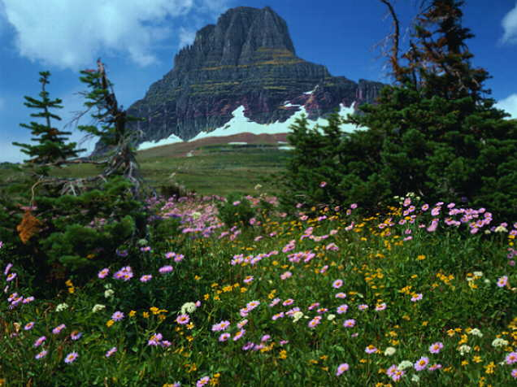

ll
I like hiking

Slide 2

Наречия too и either
тоже

Slide 3
Наречие too употребляется в утвердительных предложениях.
Например:
He likes ice cream. Он любит мороженое.
She likes ice cream too.Она тоже любит мороженое.

Slide 4
Наречие either употребляется в отрицательных предложениях.
Например:
I don’t like milk. Я не люблю молоко.
He doesn’t like milk either. Он тоже не любит молоко.

Slide 5
Look at the pictures and make up sentences with too or either.
Model:
He likes watching TV.
I like watching TV too.
She doesn’t like fishing.
I don’t like fishing either.

Slide 6
The list of pastimes

Slide 7
ll
Horse riding

Slide 8
ll
Doing sports

Slide 9
Watching TV

Slide 10
Sleeping

Slide 11
Reading

Slide 12
ll
Collecting things

Slide 13
Gardening

Slide 14
Travelling

Slide 15
Knitting

Slide 16
Playing games

Slide 17
Cooking

Slide 18
ll
Shopping

Slide 19
Hiking

Slide 20
15kkkk641
Eating

Slide 21
Playing musical instruments

Slide 22
Fishing

Slide 23
Jogging

Slide 24
Sewing

Slide 25
ll
Acting in plays

Slide 26
ll
Hunting

Slide 27
ll
Drawing

Slide 28
Dancing

Slide 29
Walking a dog

Slide 30
Swimming

Slide 31
Playing computer games

Slide 32
ll
Singing

