Slide 1
“Computers aren’t intelligent, they only think they are.”
Anonymous

Slide 2

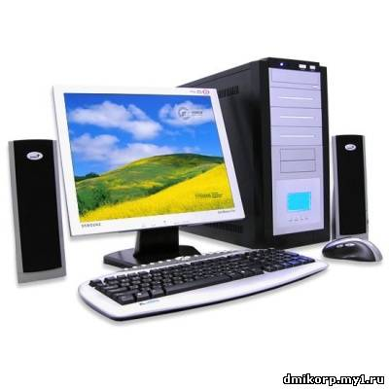
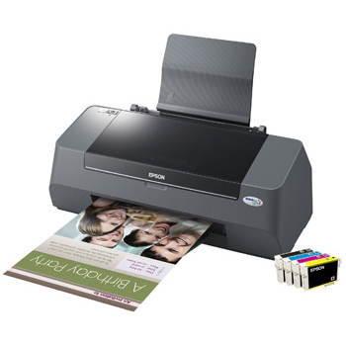
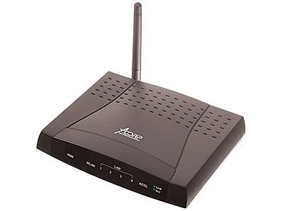

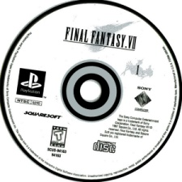
Recall the names of the objects in the picture.
Checking the homework.
speakers
CPU
monitor
printer
mouse
keyboard
cartridges
modem
CD
mouse pad

Slide 3
Procedure:
Introduction the issue of lesson
Building vocabulary & Pronunciation
/Computer parts/
Presenting the structure of definitions
Listening for details and specific words
(working out the mind map)
Using computer (group work)
Exchanging opinions on the topic
Computer jokes
Essay writing («For and against»)
Conclusion / What did we learn?
Assignment

Slide 4
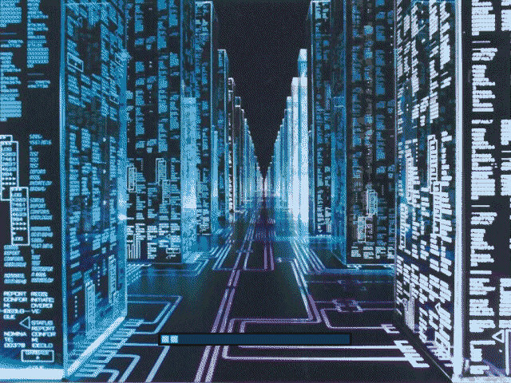
Computers:
Friends
or
foes

Slide 5
Match the definitions
access (smth)
doubt
current
on-line
predict (smth)
provide (smb with smth)
remain
replace (smth)
connected with the computer network
to supply
belonging to the present time
a feeling of being unsure
have the ability or right to enter or use
to take the place of smb or smth
to see or describe the future
continue with the computer network

Slide 6
Answer the questions. Use the glossary.
What computer system makes it possible to send
letters very quickly?
What system allows computer users around the
world to send and to obtain information?
What programs provide colourful pictures and
sound?
What is the name of a computer-created "world",
which seems almost completely real?
What is a special term, which means "to obtain
stored information from a computer's memory"?
What do we call a disk on which a large quantity
of information can be stored?
What do you call a sudden, unexpected computer
failure?

Slide 7
What is the term for the electrical or electronic
components of a computer?
What do we call a large collection of data that is
stored in a computer system?
What is the term for a set of instructions secretly
put into a computer that destroys the information
stored in it and stops it from working normally?
Where on the Internet can you look for information about products and services offered by a
company or organisation?
What is WWW?
What store of information can you easily put into
your pocket?
What do we call a set of computer programs to
control the operation of a computer?
What kind of computer can you use on the plane?

Slide 8
Listen to the interview with Mike Phillips, a journalist and add more uses of computers to the mind-map
searching
for
information
keeping
track of life
Computers are
used for
searching
for
information

Slide 9
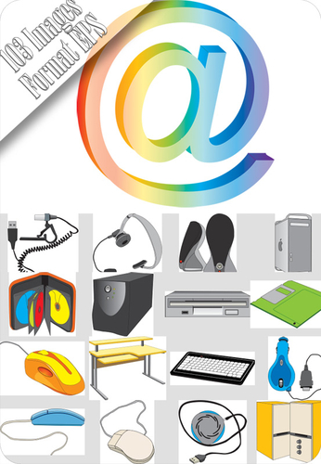
Using computer in everyday life
 | For | Against
 | Easy to find solution for complex problems. | Computer doesn’t really expand mind.

Slide 10
Exchange your opinions:
What do you mainly use computer for?
Does computer save your time?
When do you start using PC?
What kind of PC do you have?
Would you rather have a computer or person for company on a desert island?

Slide 11


Computer jokes
You can’t teach an old
dog new tricks.
You can’t teach an old
mouse new clicks.

Slide 12
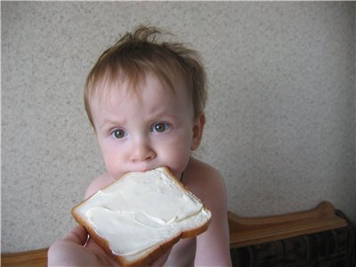

Don’t bite off more than you can chew.
Don’t take more bytes
than you can process.

Slide 13
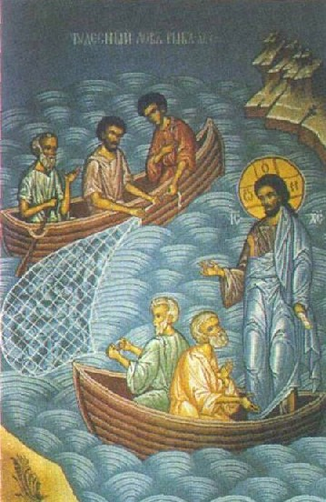
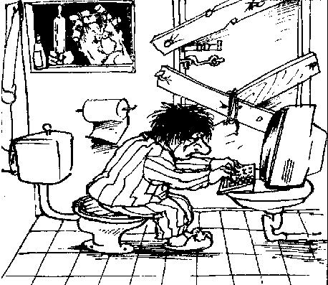
Give a man fish and you feed him for a day! Teach him to use a net and you feed him for a life time.
Give a man fish and you feed him for a day! Teach him to use the Net and he won’t bother you for long.

Slide 14


«For and against» essay
Introduction
Arguments “for” §1
present the topic and state the problem
-make a general remark about it without giving your opinion
Main body
§2
Arguments “for”( 3 points) -(support with examples)
§3
Arguments “against”( 3 points) -(support with examples)
Conclusion
§4
your opinion based on the given arguments

Slide 15
Arguments “for”
Although it is…, it has certain advantages.
The main advantage of is…
One point of view in favour of is...
Many people are in favour of convinced that…
To begin with,
Secondly,
Furthermore,
Finally,

Slide 16
Arguments “against”
However / on the other hand …
Does have its disadvantages…
The main drawback of… is…
An additional disadvantage of… is…
One point against..
Some people are against…

Slide 17
Conclusion
All things considered
Taking everything into account…
Although there some disadvantages of…
I believe it is…

Slide 18
Assignment
The Internet is a new way to communicate. Some people think it has more drawbacks than advantages.
What can you say for and against communicating by using the Internet?
Write 150-200 words essay

Slide 19
Computer is a great invention. What could our live be without a computer? Most of people of my age play online games, chat on ICQ or forums. But you know, I really miss old times, when a rare letter was so pleasant to be received! And now - everybody are at home, Internet influences them greatly. And nobody wants to dream; to write stories or poems... We all are caught in a large net. It looks like freedom, but it's a prison, though very nice to be in. So I make an appeal to focus on our life! The world around us is full of wonders...
F0rza (the Internet user)

