Slide 1


Slide 2

The Films. The genres of the film.

Slide 3
Why do people watch films?

Slide 4
Film
movie

Slide 5
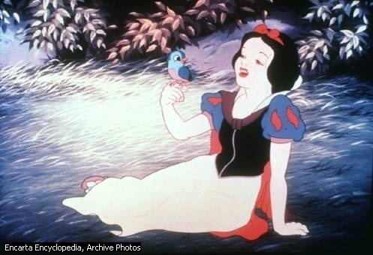
1.Feature film
A) follow the same format as features, but use images created by artists.
B) are the movies most commonly shown in large movie theaters. They typically last at least one and one-half hours and tell a fictional story or a story based on real events but portrayed by actors.
2.Animated films
3. documentary
C) are specifically intended to be shown in classrooms. Their aim is to show the natural world and some scientific facts..
4.Industrial film
D) deals primarily with fact, not fiction.
5.Educational film
e) are made by companies that want to advert their products.

Slide 6
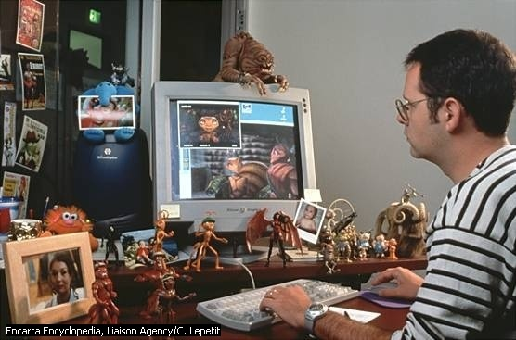
A thriller
An action film
An adventure film
A blockbuster
A cult film
A drama
A historical film
A fantasy
A horror film
A science fiction
A war film
A western
A soap opera
A comedy
A musical
A romance
A cartoon

Slide 7


Slide 8


Slide 9
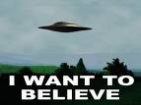

Slide 10


Slide 12
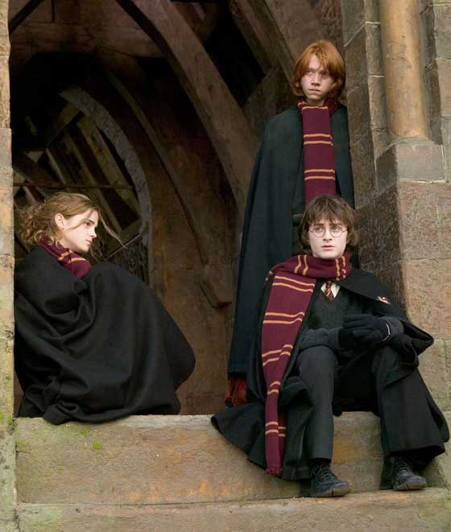
A fantasy

Slide 13


Slide 14


Slide 15


Slide 16
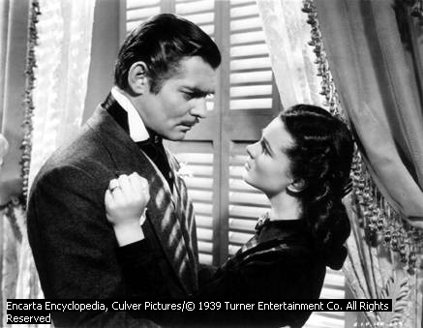

Slide 17
STARS WARS IS A SCIENCE FICTION FILM ABOUT FUTURE
CHRONICALS OF NARNIA IS A FANTASY ABOUT ADVENTURES OF FOUR CHILDREN
BATMAN IS A BLOCKBUSTER ABOUT CRIMINALS.

Slide 18
Amazing, simple, remarkable,delightful,
charming, impressive, sensitive, gripping,
Funny, powerful, terrible, fantastic, slow,
boring, violent, thrilling, breath-taking, superb, silly, fast-moving, witty, depressing

Slide 19

I AM CRAZY ABOUT
I AM INTERESTED IN
I CAN NOT STAND
I AM KEEN ON
I LIKE
I AN FOND OF
I PREFER

Slide 20


Slide 21
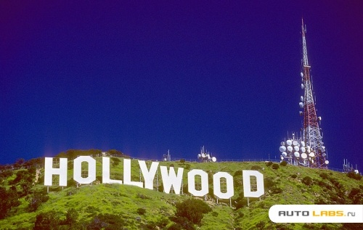

Slide 22
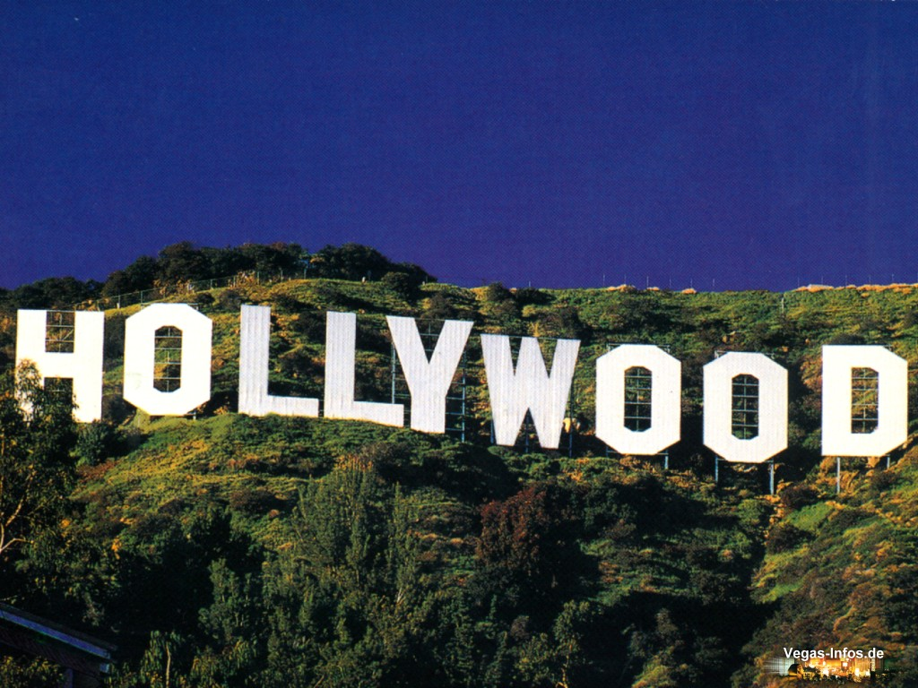
It is associated with

Slide 23
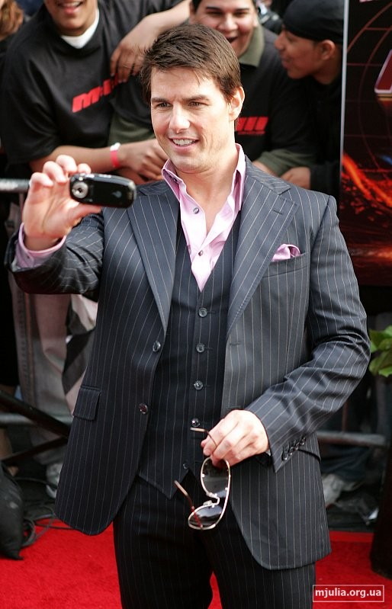
Cinematography
Mary Pickford
Douglas Fairbanks
Sidney Poitiers
Steve McQueen

Slide 24
Hollywood is the name of a Los Angeles district which appeared in 1910 and it is also stands for American cinematography .It is part of American entertainment industry aimed at amusing, educating and giving the public what it wants.America cinema was born in the east when Patent Cinema company was founded in 1908.It included 8 cinema- making films.those who did not go into this company went to the West. The independent producers soon made half of American movies, the number of film companies in California was growing. In the twenties american film industry blossomed. Producers needed more money and American banks readilly gave money as movies broughtbigprofits. Producers grew more and more dependent on businessmen. Unknown actors could become famous in a day,poor people became rich all of the sudden and hollywood becamethe town where all dreams come true.
The 1920s saw Hollywood as the centre of movie industry with a worldwide market. The production of films began in Hollywood in the late 1920s ad resulted in building huge sound stages many of which are used even now .
Hollywood helps to create theAmerican dream and to convince people that the american way of life is the ideal one. At the beginning movies were like a dream giving an escape from reality and showing that longing for happiness and success could be fulfilled.
In 1913 Mery Pickford,Douglas Fairbanks, CharlesChaplin,Bill Hart founded their own company United Artists. In the fifties several actors became producers – Lancaster, Douglas, Sinatra,Grant,Stars demonstrated their ability to be independent. In 1969 Barbara Streisand , Sidney Poitiers,Paul Newman founded their own association First Artists. Later Steve McQueen and Dustin Hofman joined them.
One of thegreatest events inHollywood is the annual presentation of Oscar ,the legendary figurine which is the highest Award of the american cinema academy. This organization was founded in 1927. its aim was to further the development of cinematograhy. Every year in February the American press publishes the titles of films which have been chosen for the competition. On the presentation day there is a magnificent show in the Los Angeles music centre. Another tradition is the ceremony of leaving one’s footprints or handprints on the pavement in front of the Chinese Theatre.

Slide 25
The word Hollywood means American
Theatre
Cinematography
A park of children
2) American cinema was born in the
East
West
South
3)Unknown actors could become famous in a day, poor people became rich all of a sudden and hollywood became the town:
a)Where all hopes break
b)Where everybody can get a job
c)Where all dreams come true
4)Hollywood helps to create the American dream and to convince people that the American
is the ideal
A fast food system
Healthy Service System
Way of life
5)When some actors became producers ,they demonstrated ability to be a
Famous
Independent
Clever

Slide 26

6) The aim of the American Cinema Academy in giving Oscars is to
Gather money for charity
Help the actors become famous
Further the development of cinematography

Slide 27
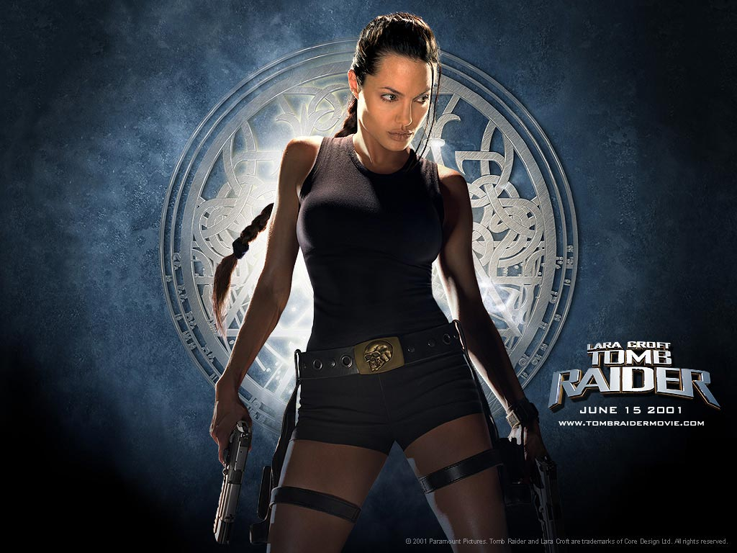
1910
1908
1920s
1913
1927

Slide 28
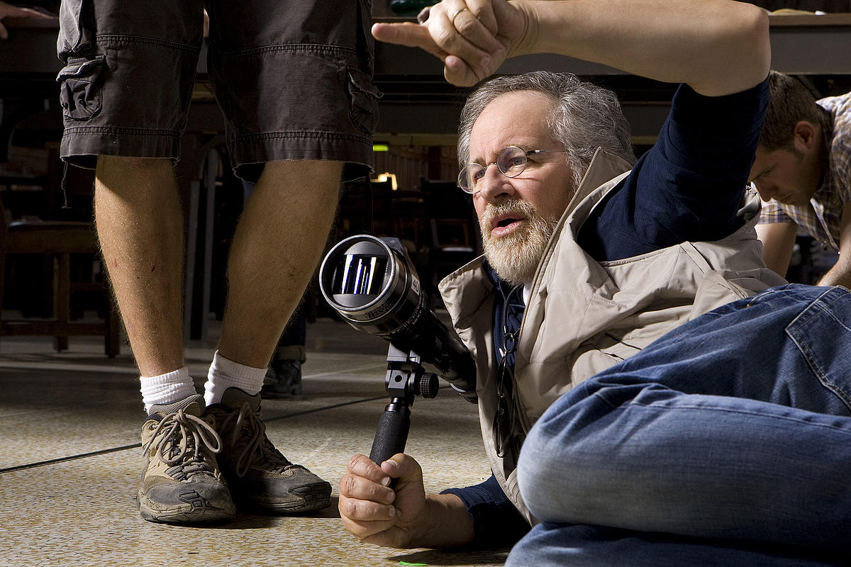
BOX OF PROFFESIONS

Slide 29
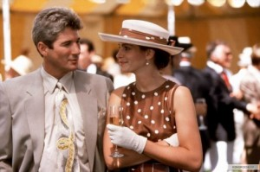
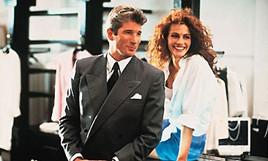


Slide 30
WHAT DO WE NEED FOR A GOOD FILM?

Slide 31
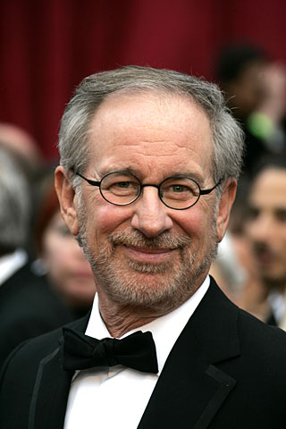
The world of Steven Spielberg

Slide 32
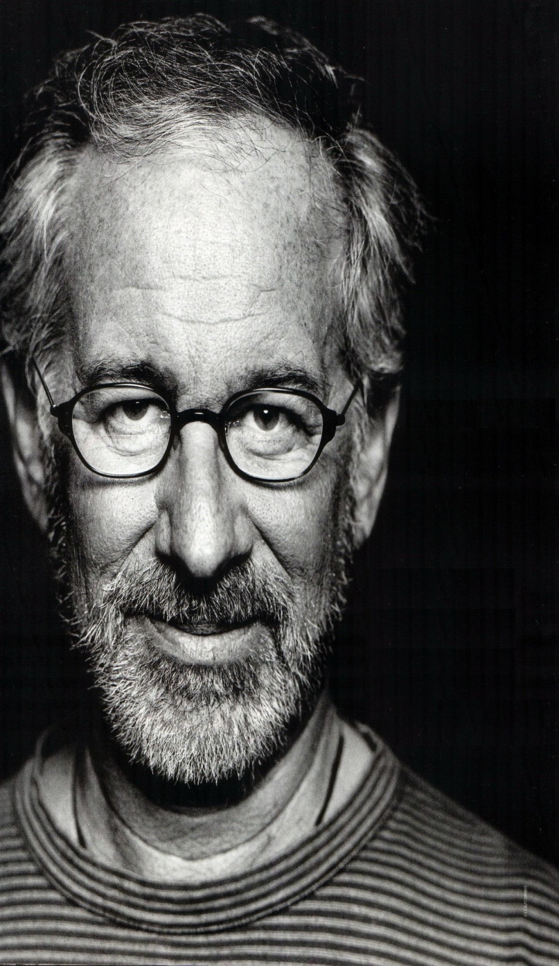
A blockbuster
A box-office success
A flop
A sequel
An Oscar winner

Slide 33
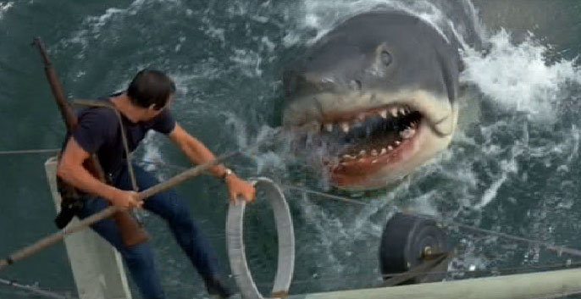
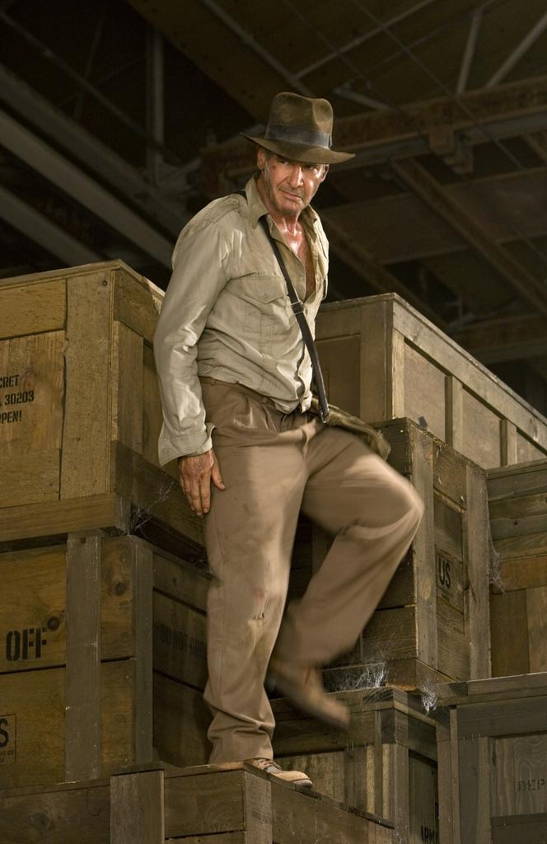


Slide 34
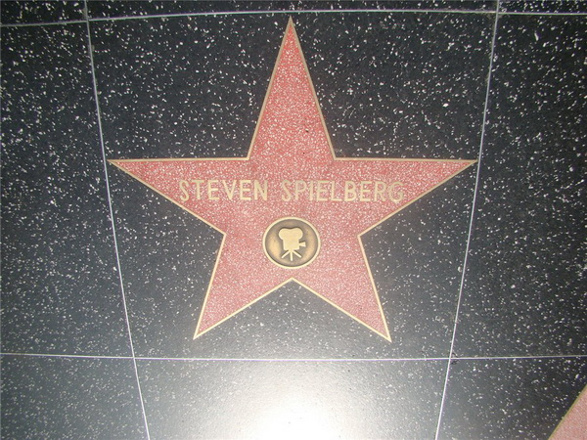
A talk show

Slide 35
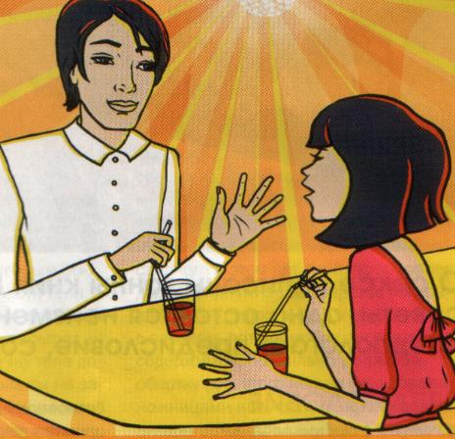
At the book -office

Slide 37
WILL/ WON’T + INF- PREDICTION IS BASED ON INTUITION, KNOWLEDGE,EXPERIENCE
MAY/MIGHT + INF – TO EXPRESS UNCERTAIN PREDICTION

Slide 38
1.The new Bond film is great. I hope it will/won’t win Oscar.
2. I might to be/be an actress one day.
3. I love Bond films. I will/might certainly go to see the next one.
4. I did not enjoy Superman ,I probably might /won’t see the sequel.
5. The lord of the rings is quite scary ,so children won’t/may not like it.
6.The plot of the Matrix is amazing .I ‘m sиre you may/will enjoy it.

Slide 39
I am not sure about Saturday. I …to the cinema.
The first film was terrible so I don’t think the sequel … very good.
Johny Depp is my favourite actor . He …ever … a bad film!
I enjoyed the film. I …the DVD.
This is a great action film. I’m sure you ….it.

Slide 40
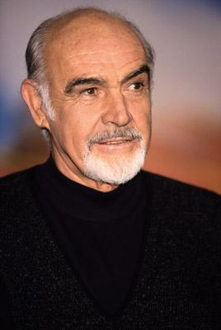

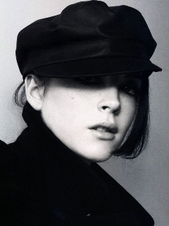

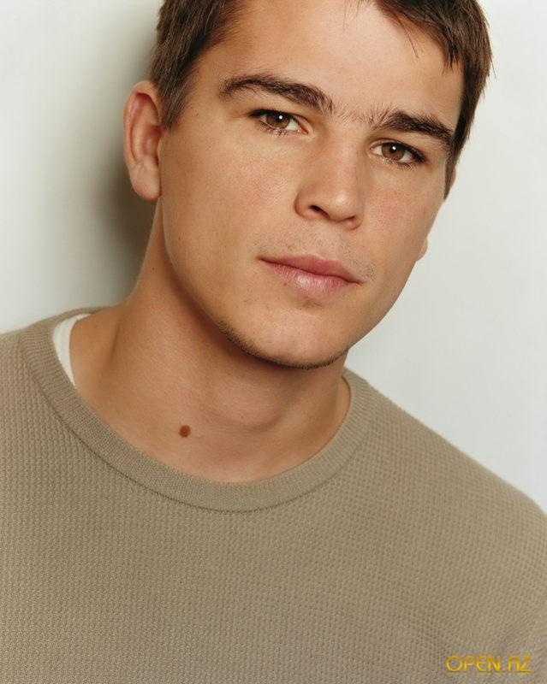
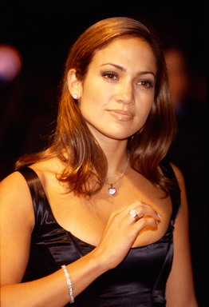

Slide 41
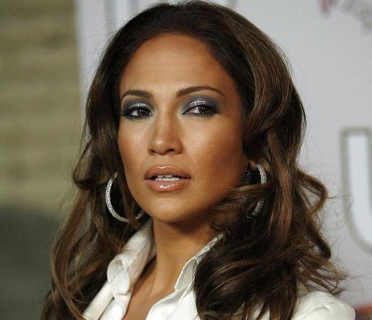
How do you choose the film ,which you are going to watch?

Slide 42
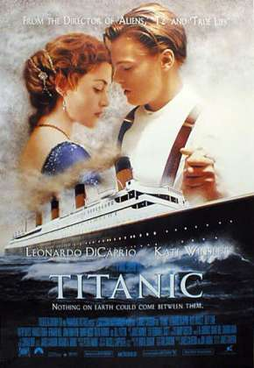

Slide 43
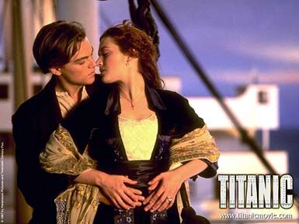

Slide 44
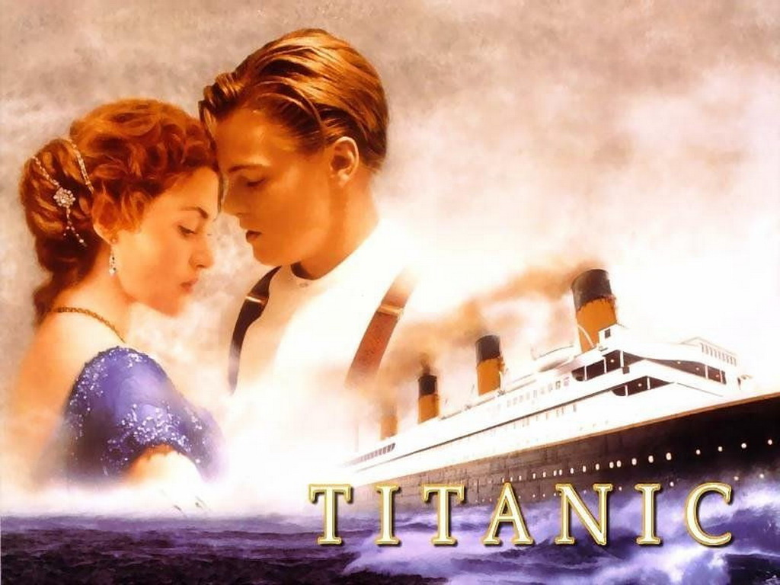
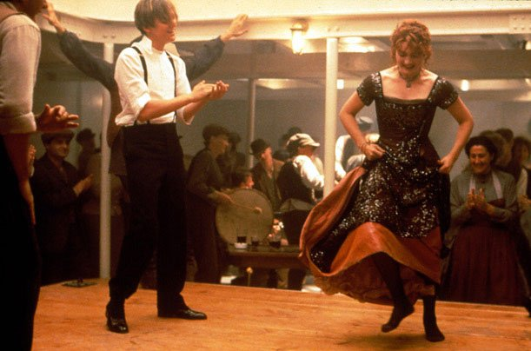
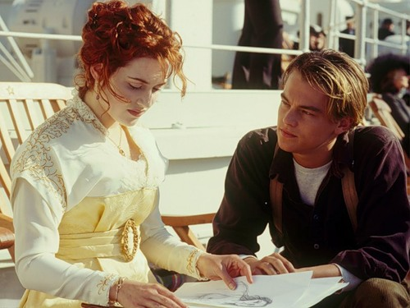

Slide 45
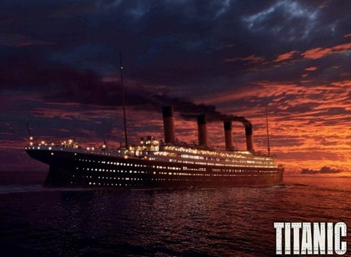

Slide 46
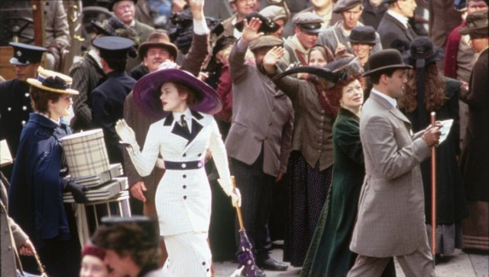
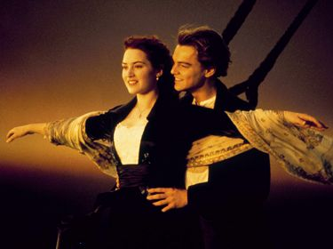
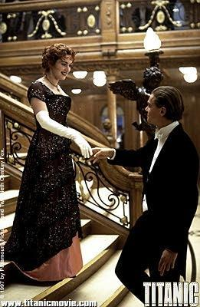
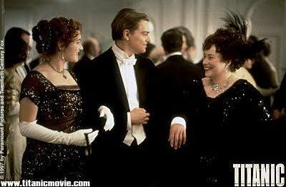

Slide 47
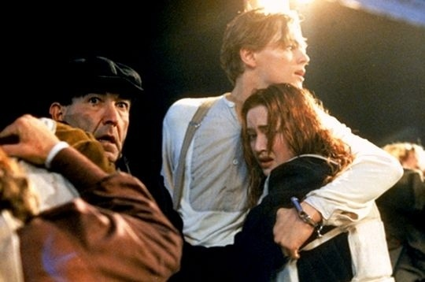

Slide 48
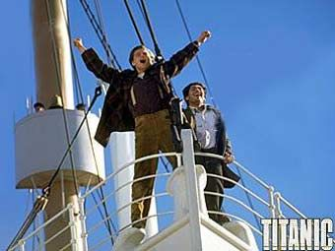

Slide 49
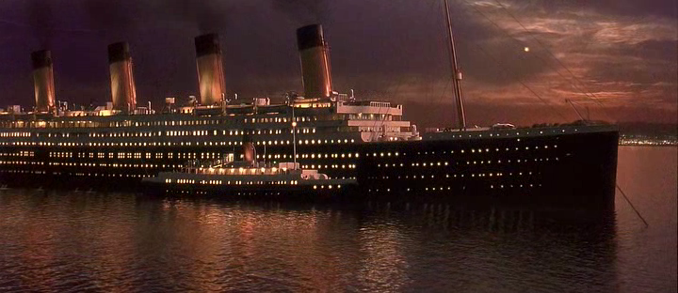

Slide 50
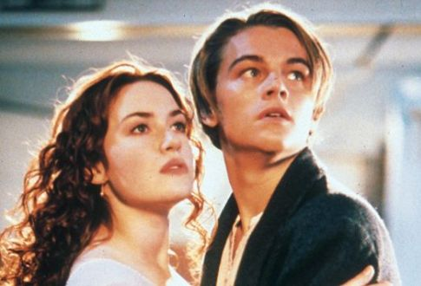

Slide 51
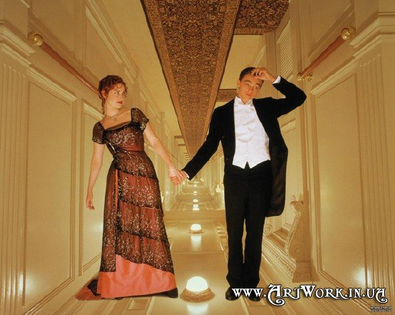

Slide 52


Slide 54


Slide 55


Slide 56
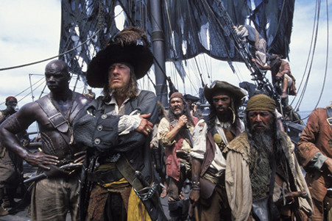

Slide 57
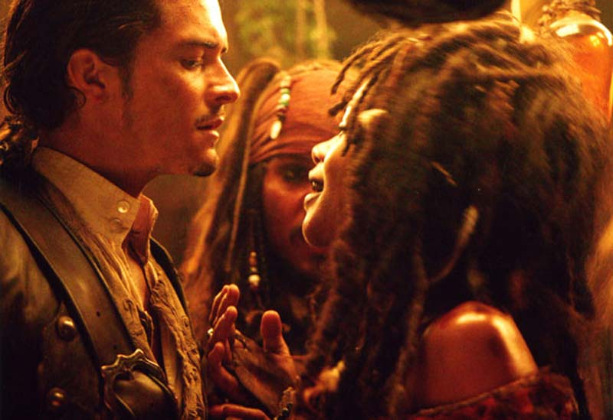

Slide 58
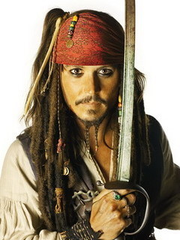



Slide 59


