Slide 1
Save our planet!

Slide 2
Word-building
suffix –tion prefix re-
to decorate- to write-
to collect- to build-
to protect- to use-
to pollute- to start-
to organise- to count-

Slide 3
Check yourself
suffix –tion prefix re-
to decorate- decoration to write- to rewrite
to collect- collection to build- to rebuild
to protect- protection to use- to reuse
to pollute- pollution to start- to restart
to organise- organisation to count- to recount

Slide 4
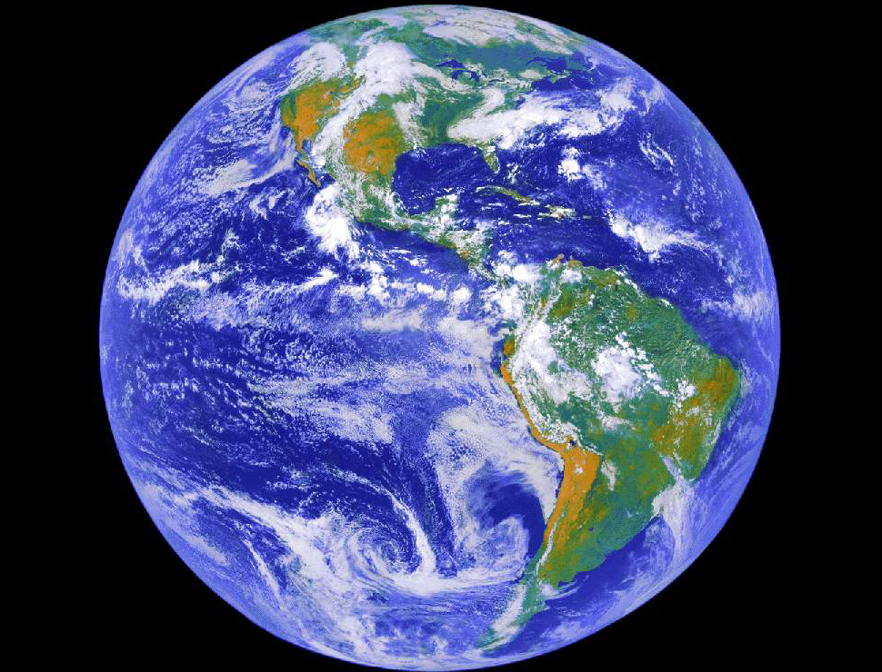
‘Mother planet is showing us the red warning light – ‘be careful’ – she is saying. To take care of the planet is to take care of our own house.’
The Dalai Lama

Slide 5
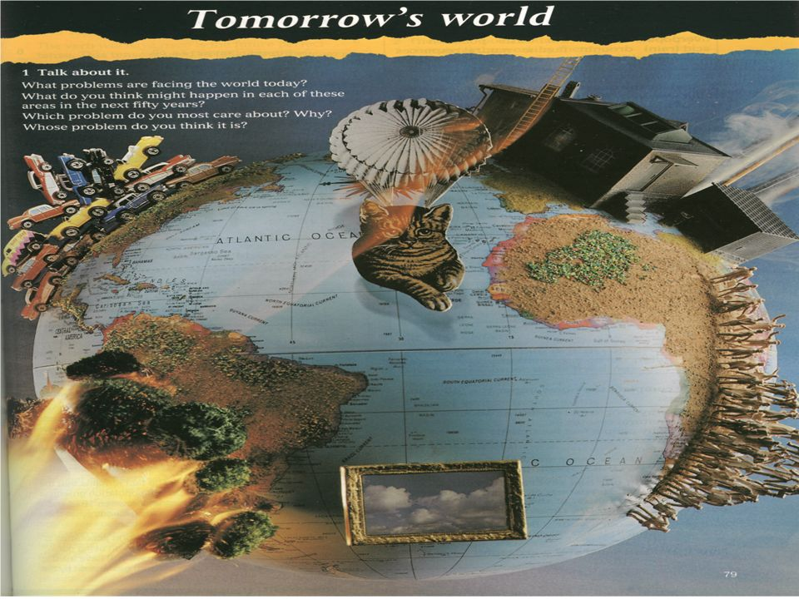
At open doors dogs come in.
Беспечность приводит к беде.
The Earth is in danger!

Slide 6
What can we do to keep the environment clean?

Slide 7
Fill in the gaps with these words: factories, the Earth, litter, cars, recycle, public transport, turn off, the forest.
We promise!
The people of ___ will protect their planet. We will built special ___ and ___ our rubbish. Some people will not use their ___
And go by ____. Children will not drop ___
and will help clean ___ . We will never forget to ___ electricity and water.

Slide 8

It’s in our hands.

Slide 9

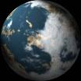
Do you know what 3Rs mean?

Slide 10
3 Rs rule
Reduce: use public transport or walk, turn off lights and water.
Reuse: shopping bags, repair old things, give old clothes to charities.
Recycle: cans, plastic bottles, paper, glass.

